Slide 1
Key Features in Quality Programs That Promote Children’s Learning
Webinar 2: The Five LIAS Learning Principles in ACTION
Notes:
Cover slide

Slide 2
Introduction by Michael Funk,
Director of the After School Division,
California Department of Education
Presentation by Stacey Daraio (Temescal Assoc.)
Brad Lupien (arc)
Via video:
Oakland Unified Superintendent Tony Smith
Dr. Judy Willis, UCSB

Slide 3
Session Outcomes
Participants will learn examples of how the LIAS principles are being applied in programs.
Participants will learn at least one way they can implement each of the principles in their programs.
Participants will hear from two youth who were trained to implement the LIAS rubric and hear the results of their assessment.
Notes:
Session Outcomes
Participants will learn examples of how the LIAS principles are being applied in programs.
Participants will learn at least one way they can implement each of the principles in their programs.
Participants will hear from two youth who were trained to implement the LIAS rubric and hear the results of their assessment.

Slide 4
For more information and resources:
Visit our website at
www.learninginafterschool.org
Notes:
For more information: visit our website at www.learninginafterschool.org

Slide 5
Introduction by
Michael Funk,
Director of the After School Division,
California Department of Education
Notes:
Michael, would you care to get it started by saying a few words about the LIAS project and the learning principles?

Slide 6
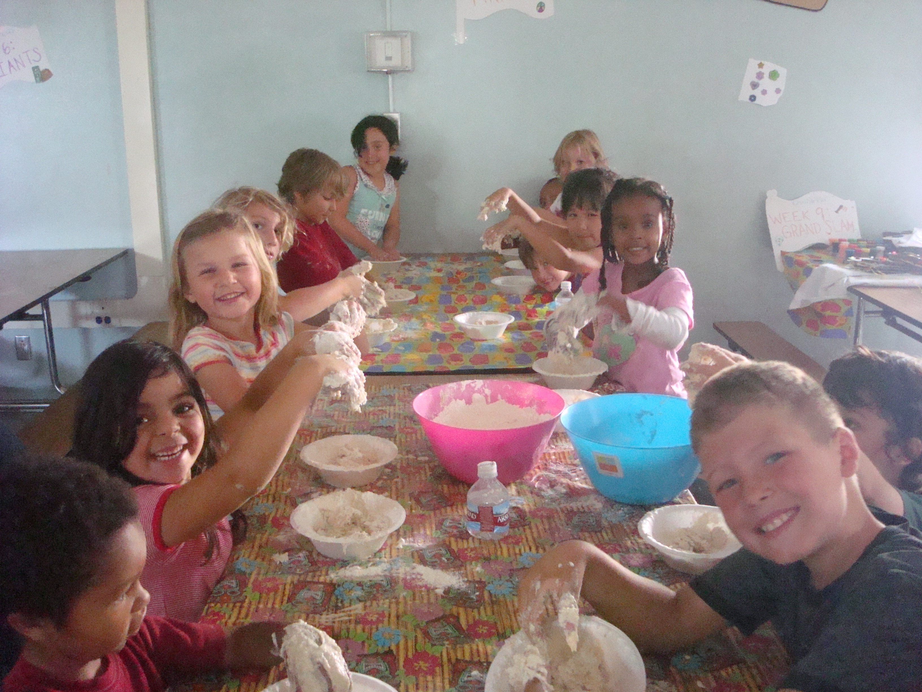
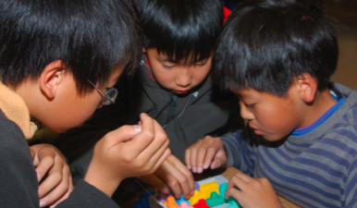
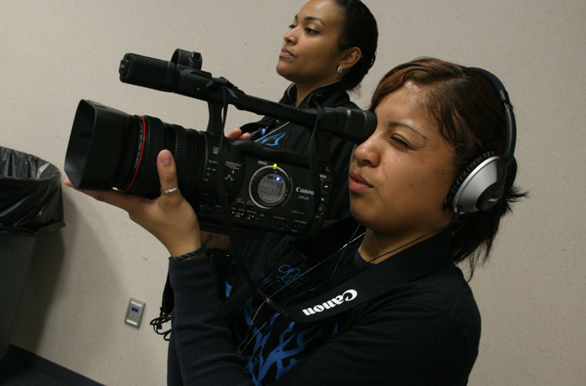
What are the 5 learning principles of the LIAS project?
Active
Collaborative
Meaningful
Notes:
Let’s review the five learning principles. The five learning principles are learning should be active, collaborative, meaningful to the participants…

Slide 7
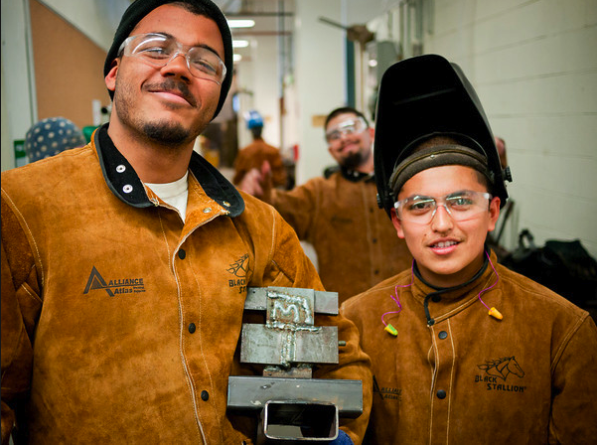
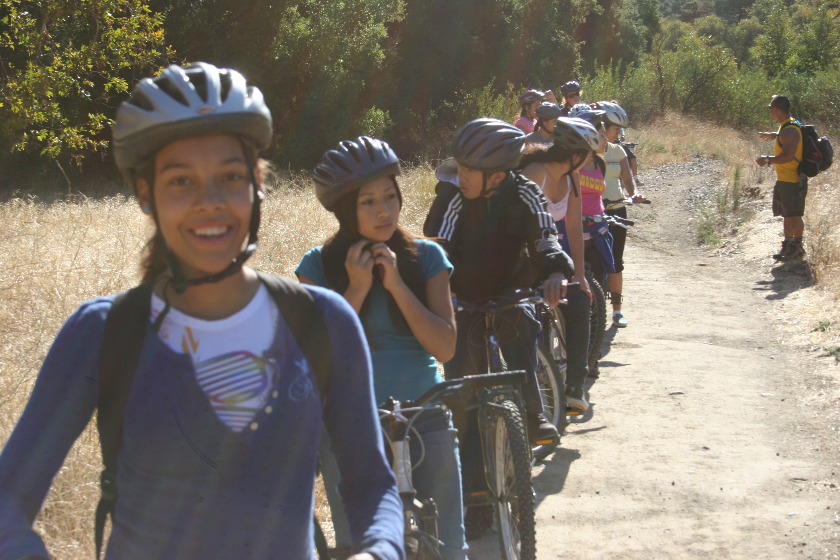
What are the 5 learning principles of the LIAS project?
Supports Mastery
Expands Horizons
Notes:
…Support their mastery and expand the horizons of participants. Let’s look more closely at each of the principles and examples of how they are implemented.

Slide 8
Participant Action!
As I talk about Learning is ACTIVE:
THINK about Active strategies you currently use
CHOOSE one you think is the most interesting
TYPE it in the chat box to the left
Notes:
As I talk about learning that is Active, I'd like you to think about one Active strategy that you currently use in your program. I know you are using many Active strategies, because we are a lot of people, I’m going to ask you to just choose one, the one that you think is the most interesting and type it into the chat box. We will be thinking about our strategies for each of the 5 learning principles and sharing them as we go along.

Slide 9
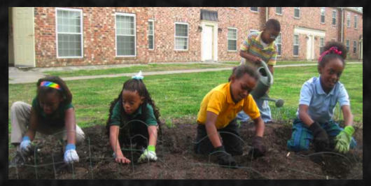
Learning is ACTIVE
Learning and memory recall of new knowledge is strengthened through different exposures – seeing, hearing, touching, and doing. Afterschool learning should be the result of activities that involve young people in “doing” – activities that allow them to be physically active, stimulate their innate curiosity, and that are hands-on and project-based. Hands-on learning involves the child in a total learning experience, which enhances the child’s ability to think critically.
Notes:
The definition for learning that is Active is: Learning and memory recall of new knowledge is strengthened through different exposures – seeing, hearing, touching, and doing. Afterschool learning should be the result of activities that involve young people in “doing” – activities that allow them to be physically active, stimulate their innate curiosity, and that are hands-on and project-based. Hands-on learning involves the child in a total learning experience, which enhances the child’s ability to think critically.
Those of you who participated in the last webinar may remember Dr. Judy Willis commenting on multiple exposures or modalities and its support of long-term memory and recall of information. It was very compelling, so I’d like for all of us to hear it again. (Video file 2889, 1:47-3:13, 2min)

Slide 10
Dr. Judy Willis, neurologist turned classroom teacher

Slide 11
Learning is ACTIVE: Curriculum Example
Developmental Studies Center Kidzlit©
Increase motivation to read
Increase literacy skills
Reinforce pro-social behaviors
Notes:
It is important that your staff and your participants have the skills to be active while learning, without losing control. This means that “active learning” is part of the program culture.
One way to ensure that the learning in your program is “active” is to select and use a curriculum that incorporates very active teaching and learning methods. One example of a highly active curriculum is DSCs Kidzlit program. There are many out there and we will present you with other resources at the end of this webinar. Kidzlit is designed to increase youth's motivation to read, increase literacy skills as well as reinforce pro-social behaviors. Youth are read a book or read a book to themselves.

Slide 12
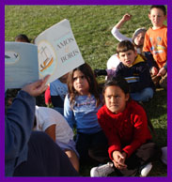
How are youth ACTIVE?
Youth are:
Listening to a story
Reading a story
Looking at pictures in a book
Reflecting on personal
experience
Talking
Notes:
How is it Active? Youth are:
Listening to a story
Reading a story
Looking at pictures in a book
Reflecting on personal experience--how do I connect to the ideas, feelings and situations presented in the book?
Talking--asking and answering questions

Slide 13
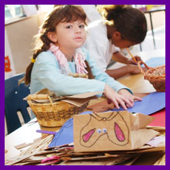
How are youth ACTIVE?
Youth are:
Doing art projects
Cooking a meal
Researching
Writing
Acting
Playing
Notes:
Depending on the topic of the book, youth then engage in specific activities like:
Doing an art project, Cooking a meal, Researching a topic, Writing an extension of the story or alternate ending, Acting out part of the book, Playing instruments
In the particular instance of Kidzlit, active strategies are engaged to support youth in understanding, processing and learning thematic content of a book. This active learning is linked to increased motivation to read, increase literacy skills and pro-social behavior.
Let’s look in the chat box and see what other kinds of strategies you are using…(Review chat box)

Slide 14
How can you incorporate ACTIVE strategies?
Review your current strategies
Choose one or more from the box on the left
Add one or more sensory modalities
Notes:
So—what are ways that you can incorporate Active Learning into what you are currently doing? Look at your clubs, or enrichment activities ask yourself are we presenting new knowledge through multiple sensory modalities such as hearing, seeing, touching, drawing, researching, playing? And, add in a new modalities.

Slide 15
Participant Action!
As I talk about Learning is COLLABORATIVE:
THINK about collaborative strategies you currently use
CHOOSE one you think is the most effective
TYPE it in the chat box to the left
Notes:
As I talk about learning that is collaborative, I'd like you to think about one collaborative strategy that you currently use in your program. Choose one that you think is the most effective and type it into the chat box.

Slide 16
Notes:
The definition is: Knowledge should be socially centered, as collaborative learning provides the best means to explore new information. Afterschool programs are well positioned to build skills that allow young people to learn as a team. This includes listening to others, supporting group learning goals, resolving differences and conflicts, and making room for each member to contribute his or her individual talents. Collaborative learning happens when learners engage in a common task where each individual depends on and is accountable to each other.
Afterschool programs are well positioned to build skills that allow young people to learn as a team. This includes listening to others, supporting group learning goals, resolving differences and conflicts, and making room for each member to contribute his or her individual talents. Collaborative learning happens when learners engage in a common task where each individual depends on and is accountable to each other.
In order for kids to learn successfully in collaboration with one another requires a program culture of collaboration and plenty of practice of collaborative skills, as listed above.
It is important that young people have these skills before they are expected to learn effectively and work smoothly together as a team. One way to cultivate these skills is through conducting group meetings where youth are taught and expected to practice these skills in a low-stakes setting.

Slide 17
Learning is Collaborative: A Program Example
California Emergency Response Team (CERT)
A program of the Federal Emergency Management Agency
Trains a group of teens (jr. high and high school students to be first responders in an emergency
Notes:
Any opportunity that requires young people to work together is collaborative. The example I am going to provide you today highlights starkly the need for youth to work together.
California Emergency Response Team (CERT) is a program of the Federal Emergency Management Agency that trains jr. High and high school students to be first responders in an emergency. Students are trained in basic first aid, search and rescue, with a focus on teamwork and the ability to coordinate with emergency professionals. Teen CERT members learn to be prepared for a large-scale disaster or emergency such as: structure fire, forest fire, earthquake, or terrorist attack. Students learn from emergency professionals and are given basic equipment to help them
be prepared.
This program is the highest stakes you can have—supporting others in an emergency, it very likely could be a life and death situation. The importance of working collaboratively with your team members is easy to see in this situation. The life lessons are critical.
There are Teen CERTs in every state. We found one place that it was happening in an afterschool program and that is in the ASES program at Julian Junior High School in Julian, California.
Lets look at what strategies you are using that you think are most effective….(REVIEW CHAT BOX)

Slide 18
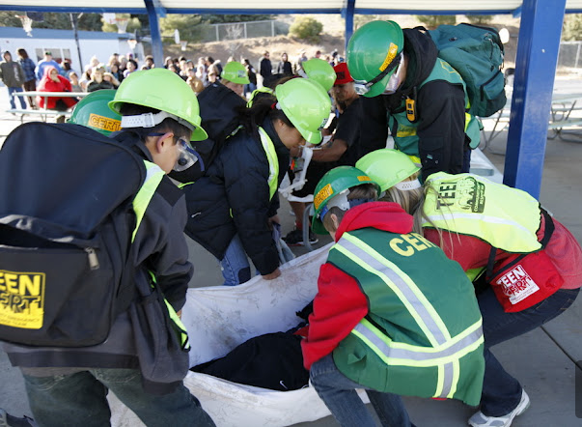
Teen CERT – California Emergency Response Team

Slide 19
How can you incorporate Collaborative strategies?
Begin by incorporating opportunities to practice collaborative skills
Choose a project that requires use of collaborative skills
Borrow from your colleagues!
Notes:
So—how can you incorporate Collaborative Learning into what you are currently doing? Remember that collaborative skills like listening, creating group goals, resolving conflict require a great deal of practice. Identify the skills you think your group needs to practice and build it into what you are doing. When the youth have the skills, choose a project that can’t get done unless youth collaborate. You can always borrow from your colleagues by choosing one or more strategy from the box on the left!

Slide 20
Student Voice / LIAS Youth Ambassadors
What is the role of youth ambassadors in the LIAS work?
History of the pilot
How youth can be involved
Incentives for involvement
Notes:
Hello everyone. My name is Brad Lupien. My organization, arc after school and experiential education programs, is an after school provider that focuses on training young people as the leaders who manage, assess, and steer their after school programs. I was asked to talk to you today about the YOUTH AMBASSADORS component of the LIAS movement. In my opinion, it is critical that we have students as part of the discussion and through the YOUTH AMBASSADORS PILOT PROGRAM we are working hard to make that happen.
Very briefly…the history of the LIAS Youth Ambassadors is:
October 2010 three socal after school providers joined with Temescal associates to provide a 3 day retreat for 25 youth leaders focused on teaching young people to use their voices effectively to promote the field.
In May 2011 and again in May 2012 representatives from that group presented to stakeholders in Sacramento at the CalSac After School Challenge
In May 2012 began using a quality self assessment rubric designed to be used by students. The rubric is a voluntary tool intended to promote true youth development. It is a pilot we are exploring the potential of.
Currently we are testing ways to ladder the ambassadors experience and incentivize students to get involved. In step #1 we are hosting regionally based student retreats to teach students about LIAS. At the retreats we ask students to look critically at their own programs and then, in step #2 students will visit other programs to share what they have learned about quality and meet in virtual work spaces to share what they are learning regionally. Our hope is that in step #3 we have educated, trained young people in a position to advocate for learning in after school. We are in the very early phases of building a badging system in which students are able to showcase through digital media and social networking sites the milestones they have accomplished as youth ambassadors.
Enough of my thoughts and comments. I would like to introduce you to three amazing young LIAS Ambassadors from Vista High School in north county San Diego…

Slide 21
Youth Ambassadors
Vista High School in north county San Diego
Amy Nguyen (12th grade)
Tiffany Blodgett (11th grade)
Allan Garry (11th grade)
Notes:
Amy, Tiffany and Alan thank you so much for skipping class today to teach all of us a little bit about youth development and quality learning through after school. I have one question for each of you and I would ask that participants write additional questions in the chat box that we will get to after each student has a chance to speak. I would ask that you keep questions to those that relate to LIAS principles, quality older youth after school, and the LIAS youth ambassadors program. Amy will be speaking first and as she answers I will put up on the screen a sample of the self assessment rubric that we have referenced before and Amy will be talking more about. So…
Amy – “Last May you attended a youth retreat at Cal State San Marcos. You and 9 classmates from Vista HS joined about 60 students from 6 other school districts to learn about leadership and compare best practices of your after school programs. Can you talk to us a little bit about how it felt to assess your program with the student, self-assessment, “rubric” we used?” FOLLOW UP: “Did you get a chance to discuss your assessment of the program with any of the after school staff at VISTA HS?” (Assuming yes)” What was that like?”
Alan –“ I have suggested that having young people at the proverbial table while we discuss program quality is critical. Can you speak to us about ways in which the LIAS Youth Ambassadors Project has helped ensure you have a sense of ownership over the direction of the after school program at VISTA? In what ways are you able to be an ambassador for the after school field and/or influence what your program looks like?”
-Tiffany – “Stacey has discussed examples of learning that is ACTIVE and COLLABORATIVE and, in a minute, will discuss learning that is Meaningful, supports mastery and expands horizons. Can you share with us an example of a class, project, or event that you have participated in through your after school program that demonstrate one of these principals?”
PARTICIPANT QUESTIONS
Thank you Amy, Tiffany and Alan for participating. I know it can be hard to present to all these virtual adults but I will speak for everyone in saying your voice is critically important to our work, to education and education reform, and to improving our communities. Thank you.

Slide 22
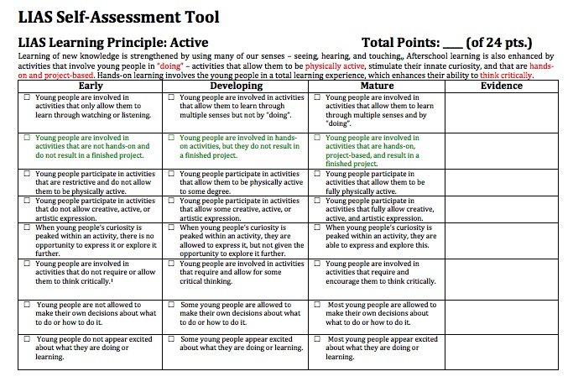
Notes:
Afterschool and summer program leaders who agreed with the LIAS position statement asked for tools to assess the absence or presence of the learning principles within their programs. In response, we created an observation rubric that program leaders and older youth can use to assess their alignment with the LIAS learning principles. You can download this rubric and a shorter version developed for youth observers on our LIAS website.
Youth assessment leaders are currently being trained by ARC to assess afterschool and summer programs in Southern California. The LIAS project also offers training to program staff and youth leaders on how to apply and assess for the LIAS principles.

Slide 23
Participant Action!
As I talk about Learning is MEANINGFUL:
THINK about meaningful strategies you currently use
CHOOSE one you think is the most unique
TYPE it in the chat box to the left
Notes:
As I talk about learning that is meaningful, I'd like you to think about one meaningful strategy that you currently use in your program. Choose one that you think is the most unique and type it into the chat box.

Slide 24
Learning is MEANINGFUL
Young people are intrinsically motivated when they find their learning meaningful. This means having ownership over the learning topic and the means to assess their own progress. Motivation is increased when the learning is relevant to their own interests, experiences, and the real world in which they live.
Notes:
Young people are intrinsically motivated when they find their learning meaningful. This means having ownership over the learning topic and the means to assess their own progress. Motivation is increased when the learning is relevant to their own interests, experiences, and the real world in which they live.
Rather than learning that is focused on academic subjects, young people in afterschool can be helped to apply their academic skills to their areas of interest and real world problems. Also, when learning involves responsibility, leadership, and service to others, it is experienced as more meaningful.
I recently heard a story on NPR by a brain scientist BJ Casey. She talked about how a decade ago scientist began publishing reports that described adolescents as people who are impulsive, make bad choices and are risk takers. Now, ten years later, we have a different picture of the adolescent brain. Here’s the condensed version of the story: Casey wanted to study the brain’s reward center which produce pleasurable feelings in response to things like drugs, sex, food and thrill seeking behavior. Past research had shown that in comparison with the adult brain, adolescents have a much higher sensitivity to rewards. Such a high sensitivity that they might seduced to do things in the moment that they know they shouldn’t do. Casey wanted to know whether that sensitivity to rewards could work to support good decision-making. So she did what scientist do and crafted a study with both adolescents and adults—turns out that adolescents—and NOT adults—were able to wait and not act impulsively to receive a reward in response to a positive reward—if they want it, if its meaningful, adolescents can and will restrain their impulsive behavior.
I love this study because it encourages us to look at rewarding positive behavior instead of negative behavior and it looks like, left to their own devises, adolescents will attempt to incentivize positive behavior.

Slide 25
McLane High School ASSETs Program (Fresno, CA)
Freshman Summit on Slowing Drop Out Rate
Certificates
Rewards for improving grades
Notes:
At McLane High School ASSETs Program in, Fresno, CA they engage their students in many activities that are meaningful, however, one corroborates the study above:
They have a Freshmen summit on slowing drop out rate: A group of freshmen youth meets regularly to discuss strategies for slowing the drop out rate. Some strategies
include handing out certificates to freshmen who have attended a certain number of
school days, and they receive rewards for grade improvement. They have chosen to reward positive behavior, instead of rounding up all the students who have missed school, or are performing poorly. At the end of the year, the group of freshmen prepare up a report of what schools and the government can do to slow the drop out rate, and send it to the school district. The event is led by youth in all grade levels 9-12.
This project deals with a meaningful real world problem—the drop out rate, youth have the opportunity to strategize and report out on their learnings to not only their school, but the district as well.
Let’s look in the chat box and see what other kinds of strategies you are using…(Review chat box)

Slide 26
How can you incorporate MEANINGFUL strategies?
Assess your youth’s interests
Link learning to their interests
Choose one or more from the box on the left
Notes:
How can you increase Learning that is Meaningful? The first thing you need to understand is what is important to your youth. MacLane’s program is for adolescents, but even younger children have interests and experiences that are meaningful to them and can use those interests and experiences in a leadership capacity.

Slide 27
Participant Action!
As I talk about Learning that SUPPORTS MASTERY:
THINK about strategies you currently use
CHOOSE one you are most proud of
TYPE it in the chat box to the left
Notes:
As I talk about learning that supports mastery, I'd like you to think about one strategy that you currently use in your program. Choose one that you think you are most proud of and type it into the chat box.

Slide 28
Notes:
If young people are to learn the importance and joy of mastery, they need the opportunity to learn and practice new skills that are sequenced and layered in a way that allows them to become “really good at something.” This can be achieved by offering activities that lead to a culminating event or product that can be viewed and celebrated by peers, family, and community members.
I was working with an instructor who taught a skateboarding class at an elementary school afterschool program. He was having a lot of difficulty with his class—and it was very well attended. The young people were not focused, got frustrated easily, and were generally not supportive of each other—but they kept showing up week after week. Wow! What a great problem to have. First of all, how lucky to be able to teach skateboarding, I know a lot of programs that won’t offer it because of liability issues. But what is going on here? Doesn’t really sound like a fun class to be in if youth are cranky, unfocused and capping on each other all the time. I had a sense that the youth really wanted to learn how to skateboard. The instructor told me-- of course they want to skateboard—they want to start with all the really hard skills. That was a great clue that this challenge had to do with Mastery.

Slide 29
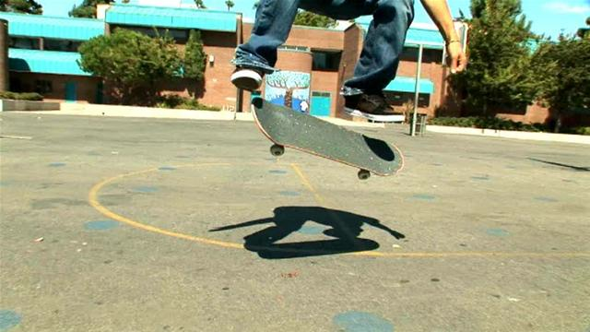
Learning that Supports Mastery: Skateboarding!
Skills:
Stand on the board
Push
Stop
Carve or turn
Kick turn
Cruise
Notes:
I asked him to tell me all of the skills needed, in order, to get to a fancy skill. He said. I asked him if he had explained the progression of skills to the youth. He hadn’t. I asked him if some of the youth had some proficiency in some of these skills, he told me that some did. We looked at tweeking his program so each young person identified the fancy skill they wanted to do and then created a list of the skills they needed to ‘get really good at’ before they attempted the fancy skill. Then, we had youth who were good at standing on the board, or pushing or cruising begin to teach those youth who weren’t so good at those skills. They determined a time, far enough in the future, for a skateboard demonstration—where they could show off their skills. Each week, youth identified what they were working on, and set about to get that skill under their belt. At regular intervals, the youth demonstrated their skill to the group and the group gave them feedback on what to work to improve the skill or gave them the go ahead to start working on the next skill on their list. The skateboard demonstration gave the youth a natural timeline to learn their fancy skill.
By linking something that the youth REALLY wanted (the fancy skill) to a clear progression of skills and an opportunity to show case their skills created learning that supported mastery.

Slide 30
Participant Action!
As I talk about Learning that EXPANDS HORIZONS:
THINK about strategies you currently use
CHOOSE one you most want to share
TYPE it in the chat box to the left
Notes:
As I talk about learning that expands horizons, I'd like you to think about one strategy that you currently use in your program. Choose one that you most want to share and type it into the chat box.

Slide 31
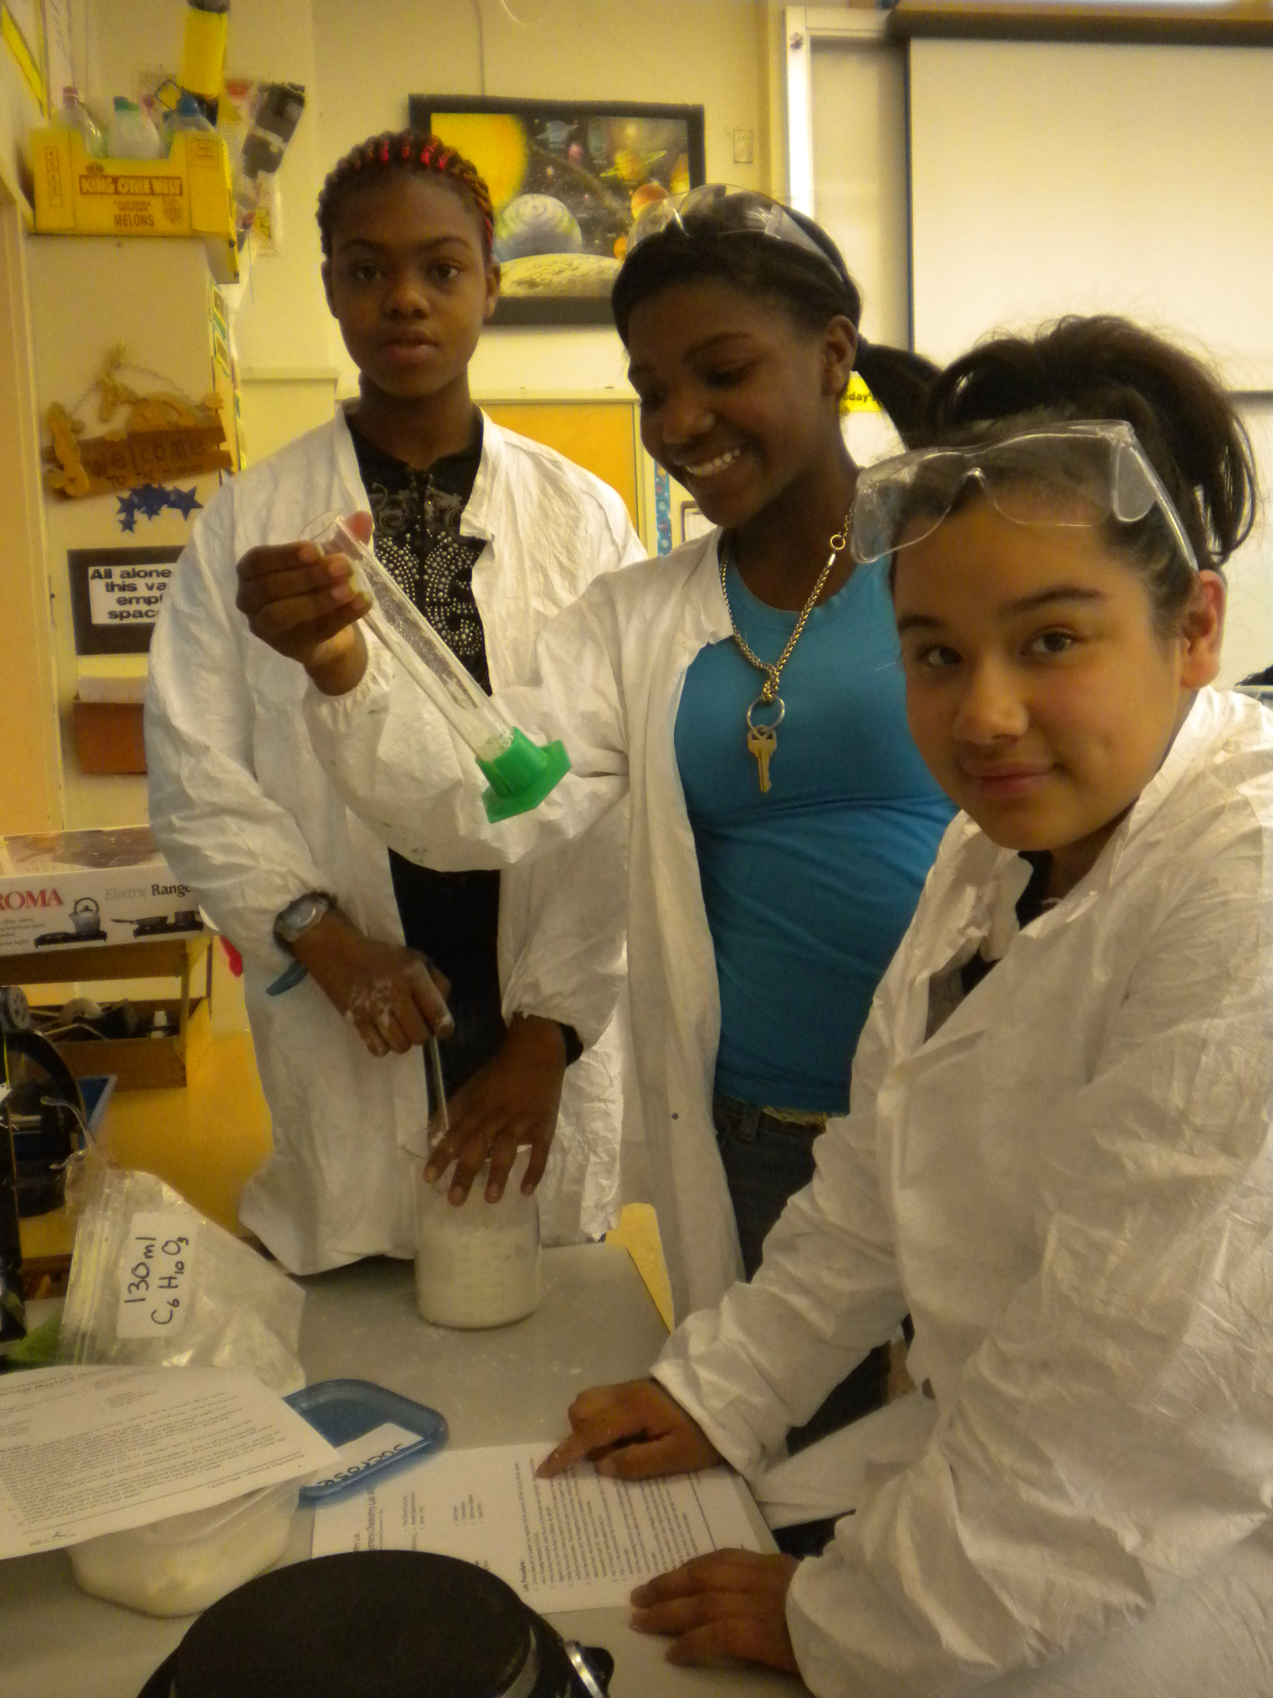
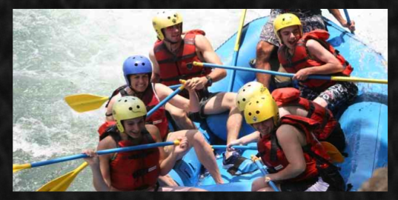
Notes:
Young people benefit by learning opportunities that take them beyond their current experience and expand their horizons. Learning about new things and new places promotes a greater sense of potential of what they can achieve. Afterschool programs can go beyond the walls of their facilities to use the surrounding community as a classroom. Expanding horizons also includes helping youth to develop a global awareness, increasing their knowledge of other cultures and places, and their understanding of the issues and problems we have in common across cultural and political divide.
If you attended the last LIAS webinar, you may remember OUSD Superintendent Tony Smith commenting that while all the LIAS principles were important, he thought that all adults needed to take seriously their responsibility to encourage, activate and energize young people in seeing possible futures for themselves and he stressed that the afterschool was uniquely positioned to accomplish this because we are not tethered to the building. We can walk out the doors of the school.
Of all the principles, this is the one where I encounter the most push-back from practitioners. If there are programs in place to expand horizons like internship programs, college tour programs, regular field-trips, career exploration, practitioners seek only to improve their programs, and can expound on the impact on youth and their program. Those practitioners with no programs in-place, have a difficult time seeing how to implement this principle without additional resources. That makes sense—how can you take kids on college tours up and down California if you don’t have the resources for transportation, lodging and food?
I’d like to offer that even if you don’t have additional resources, you can still take seriously your responsibility of encouraging, activating and energizing possible futures for your youth without leaving your building.

Slide 32
Virtual College Tours?
Connect with college
Info sessions and tour via Skype
Access student groups on-line
Siblings of your youth currently in college?
Notes:
Let’s take the college tour program. Can you or your youth connect with someone at the colleges you are interested in and do virtual tours? Tours where you are communicating with the college, seeing video from the campus and doing informational sessions over Skype? How can you access student groups on-line and have an on-going conversations? Do your youth have older brothers or sisters who are at college who can come in and address your students? What are all the resources: internet, snail mail, siblings or cousins in college, that you can access to bring that “college tour” experience to your door?

Slide 33
EXPAND HORIZONS: Curriculum Example Virtual Vacation
Virtual Vacation: An Academic and Cultural Approach to Afterschool Education
Academic, cultural and creativity based program
Virtually travel!
Notes:
Another example of Expanding Horizons without leaving the building is Temescal Associates Virtual Vacation: An Academic and Cultural Approach to Afterschool Education. Virtual Vacation is an academic, cultural, and creativity based program developed specifically for an afterschool setting. Participants virtually travel to a destination or period in history and learn about it through academic and creative components. Participants are enveloped by the culture of the chosen destination through a multitude of activities. The activities can be aligned with grade level standards.

Slide 34
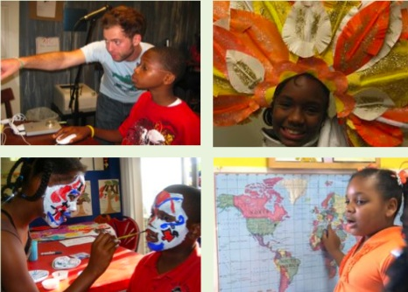
Virtual Vacation: Academic Components
Geography
History
Language Arts
Math
Science
Notes:
Specifically the academic components are: geography, history, language arts, math and science.

Slide 35
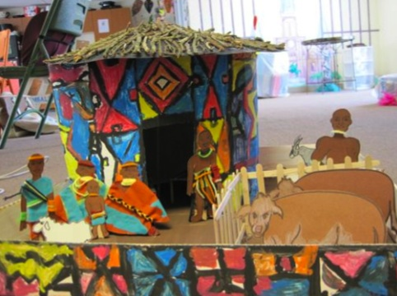
Virtual Vacation: Creative Components
Culinary Arts
Cultural Studies
Fine Arts
Performing Arts
Music
Sports and Fitness
Notes:
The creative components are: culinary arts, cultural studies, fine arts, performing arts, music, and sports and fitness.

Slide 36
How can you incorporate EXPAND HORIZONS strategies?
Assess your resources
Invite a neighbor, parent/caregiver, community member in to your program
Choose one or more from the box on the left
Notes:
How can you increase Learning that Expands horizons? Assess your resources, can you craft a program that brings your youth out of the building and community they live in? If not, why not bring the outside into your program by inviting a neighbor, parent or caregiver, or a community member into your program and sharing a new perspective. You can always borrow from your colleagues!

Slide 37
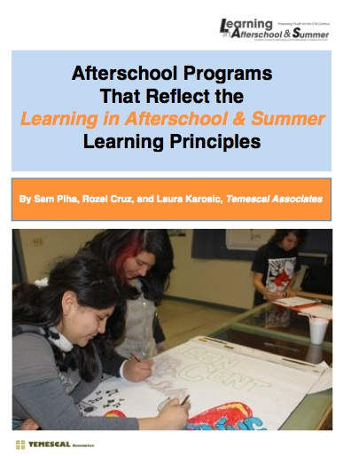
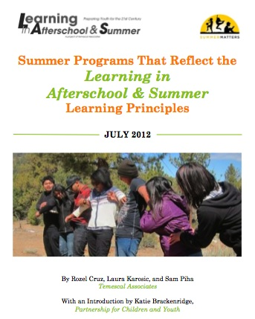
For more examples of the LIAS principles, see activities cited in our Summer and Afterschool papers:
Notes:
For more examples of the LIAS principles, see activities cited in our Summer and Afterschool papers. We are lucky to have many sites up and down California that are implementing the LIAS principles with a high level of quality.

Slide 38
www.temescalassociates.com
Notes:
The leader’s guide to Virtual Vacation is available by visiting the Temescal Associates website: www.temescalassociates.com

Slide 39
Questions/Discussion

Slide 40
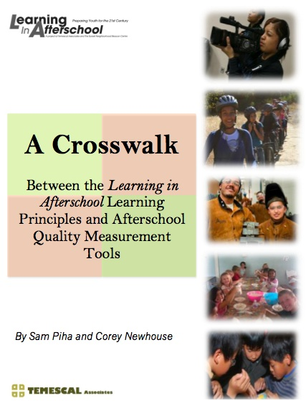
Notes:
Some programs were already using their quality assessment tools to guide program improvement. To assist theses programs, we conducted a Crosswalk between the indicators of commonly used quality assessment tools and the LIAS principle, which we published in a paper. We also researched papers that provided profiles of actual afterschool and summer programs in California that were well aligned with the LIAS principles. These also can be found on the LIAS website.

Slide 41
http://learninginafterschool.org/
Become a co-signer to promote quality learning in afterschool and summer
Follow the LIAS blog
Access tools, resources, videos, as well as the observation rubrics
Follow us on Facebook & Twitter
Notes:
This webinar has worked to introduce the listeners to the Learning in Afterschool & Summer five key learning principles. We have training materials and exercises you can use to introduce your staff or other stakeholders in the Learning in Afterschool & Summer principles. This webinar will also be archived by the California Afterschool Network. All of these can be found on the LIAS website.
GET INVOLVED! If you agree that afterschool and summer programs should incorporate these learning principles, go to our website and become a co-signer to the position statement.
You can also go to our website to:
Follow the LIAS Blog, which features interviews with field leaders and updates on relevant issues
Access tools, resources, videos, as well as the observation rubrics
Follow us on Facebook & Twitter

