Slide 1

“ACE Program”
(Achievement and Commitment to Excellence)
      Welcome to the-

Slide 2


ABOUT US
Year Founded:
1990 - Incorporated as a 501c3 Non-Profit Educational Foundation
Los Angeles Area Based:
Have provided services across the nation & world
Number of People Served:
Approximately 60,000 youth
Approximately 40,000 educators & parents
Over 400 school & youth-serving organizations

Slide 3
OUR MISSION
To inspire and empower
young people to become responsible citizens, compassionate leaders,
and live their dreams.

Slide 4
“ACE”
Achievement
Commitment
Excellence
PROGRAMS & SERVICES
STUDENT PROGRAMS
ACE Program
ACE 1-Day Workshop
ACE Leadership Institute
PROFESSIONAL DEVELOPMENTS
PARENT WORKSHOPS
AFTERSCHOOL PROGRAMS MANAGEMENT

Slide 5

Attitudinal Development
Personal
Leadership
Emotional
Intelligence
Cultivate
Academic Knowledge
and Skills
Interpersonal
Skills

Slide 6
THE BIGGER PICTURE
Developing a more respectful and caring learning environment that honors each person and fosters creativity, cooperation and achievement
Building the foundation for “safe” schools from the inside-out through character education and asset building
Developing a more pro-active and trusting culture

Slide 7
“Whoever our students may be,
whatever subject we teach,
ultimately we teach who we are.”
~ Parker J. Palmer

Slide 8
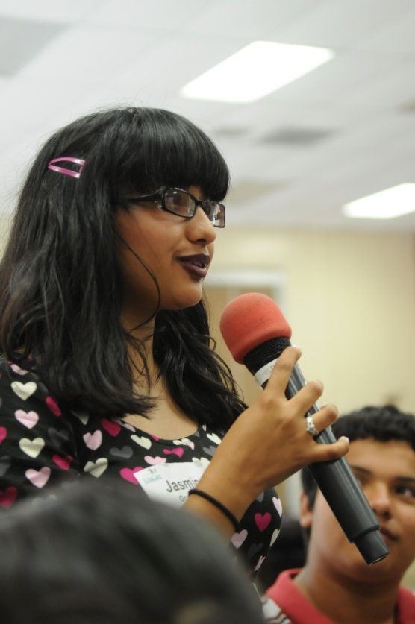
WHAT IS ACE?
An interactive & fun student success, empowerment, and character-building program…
Participants learn through instruction, example, and experience…
Participants do various indoor & outdoor activities, and also have the opportunity to discuss issues relating to teens!!
“ACE”
Achievement
Commitment
Excellence

Slide 9
STRUCTURE
ACE PROGRAM
ACE Professional Development
ACE Student 3-day Program
ACE Family Evening
ACE Curriculum
ACE Follow-up Workshops
Integrate into ongoing after school programs

Slide 10
KEY OBJECTIVES
ACE PROGRAM
Building Connections & Relationships:
Student to Student
Teachers (Adults) to Students
Fostering the “3Rs”:
Respect (self and others)
Resiliency (skills for self-esteem & wise decision-making)
Responsibility
Creating a more Positive School Climate:
Cultivate a more effective learning environment
Build a sense of comfort & “safety”

Slide 11
Eight (8) Skills for Practicing
Heart-Centered Education
SKILL #1: Seeing the Best in Everyone - Honoring
SKILL #2: Positively Reinforcing - Praising
SKILL #3: Listening from the Heart
SKILL #4: The Power of Choice -
Facilitating youth to be personally responsible
SKILL #5: Resolving Conflict
SKILL #6: Moving from Judgment to Forgiveness
SKILL #7: Turning Challenges into Learning Opportunities
SKILL #8: Giving and Receiving

Slide 12
HONORING
“We invoke each other’s potential by our willingness to see the essence of each other.”
~ Peter Senge

Slide 13
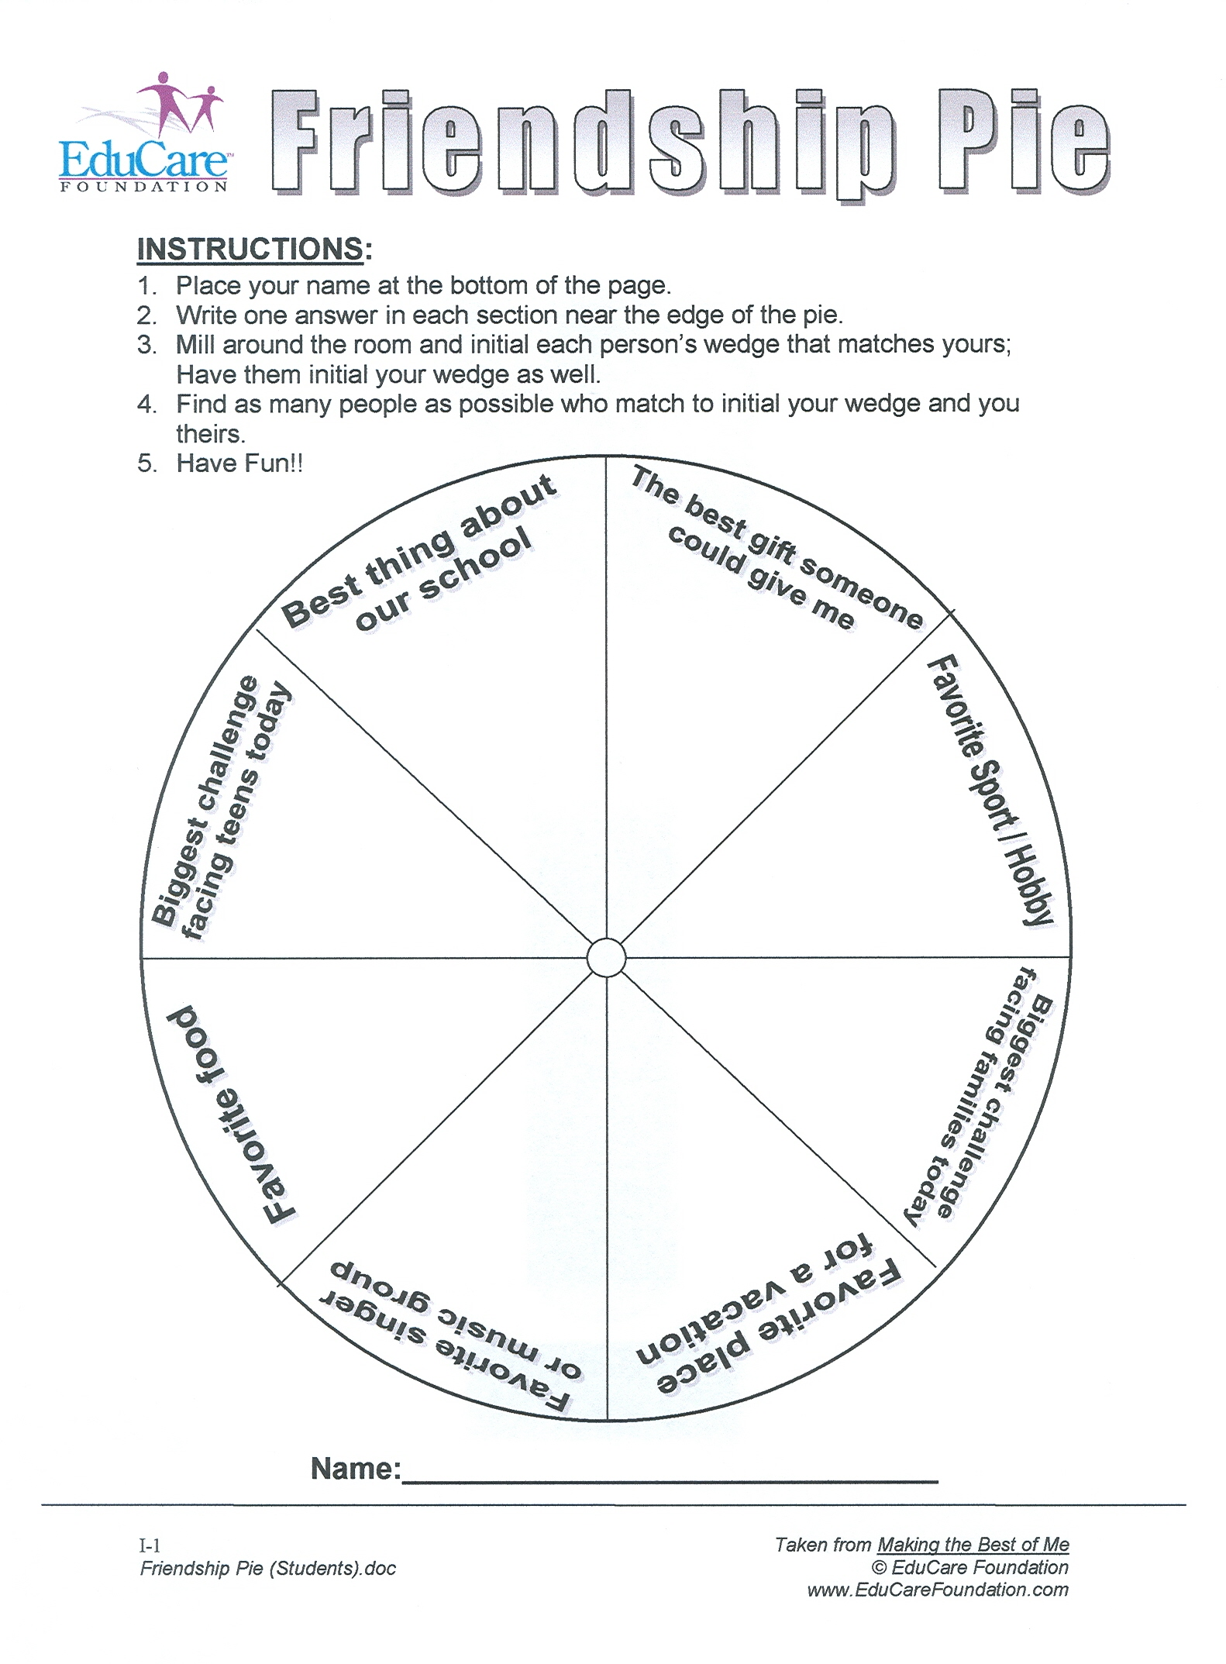
FRIENDSHIP PIE

Slide 14
FRIENDSHIP PIE
INSTRUCTIONS:
Place your name at the bottom of the page
Write one answer in each section on the outside edge of the pie
Mill around the room, exchange papers, and initial each wedge that matches yours; have them initial your wedge as well
Find as many people as possible to exchange papers with
Have fun!

Slide 15
FORMAT
ACE PROGRAM
Interactive three-day workshop composed of 50 - 125 youth with a minimum 10/1 youth-to-adult ratio
The larger group is divided into smaller “resource groups” of (7-10 students & one adult) for structured teambuilding and experiential activities.
Program is composed of large & small group activities, lecturette & skits, taking place both indoors and outdoors.

Slide 16
LEVELS OF LISTENING
Listening from the
HEART
Empathic
Attentive
Selective
Ignoring
Pretending

Slide 17
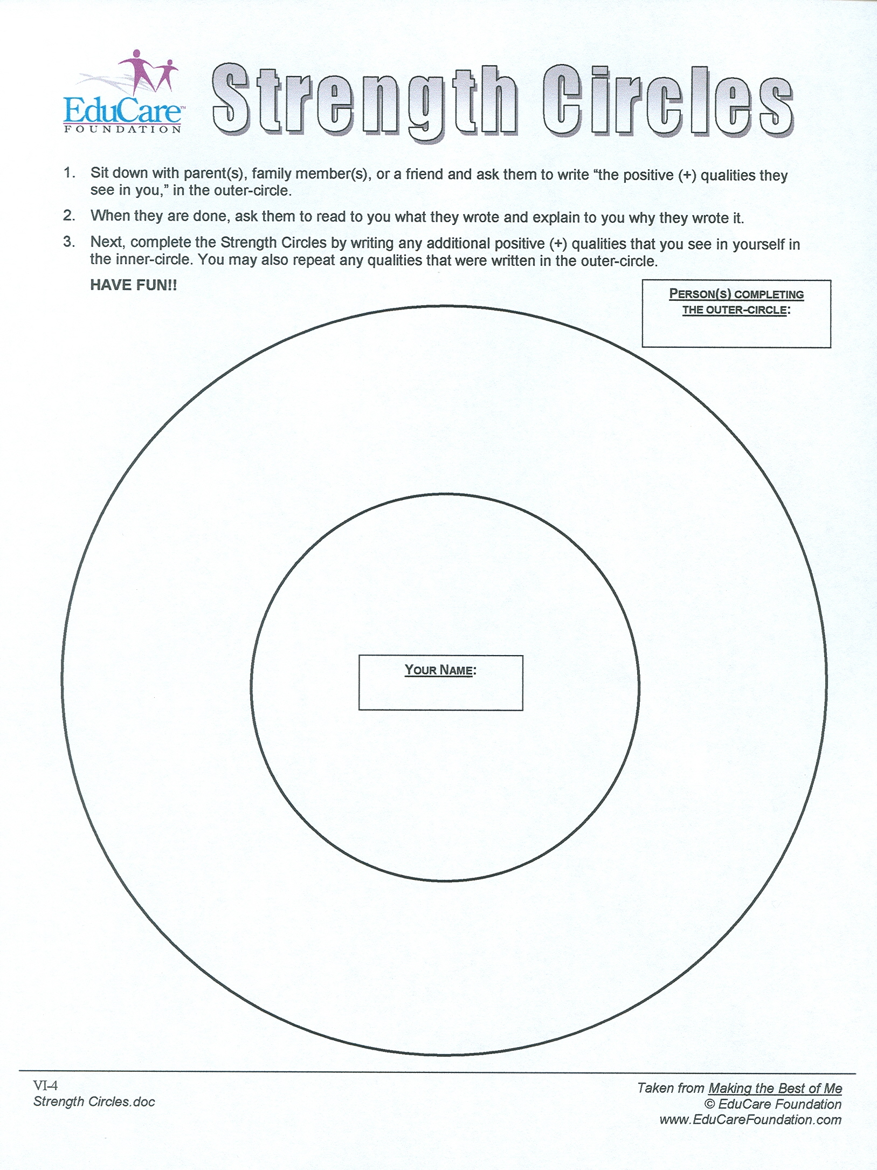
STRENGTH CIRCLES

Slide 18
STRENGTH CIRCLES
INSTRUCTIONS:
Give your partner your paper. Ask him/her to write the positive qualities they see in you in the outer circle
Have them share what they wrote and why they wrote it.
Write any additional positive qualities you see in yourself in the inner circle
(You may rewrite what your partner shared)

Slide 19
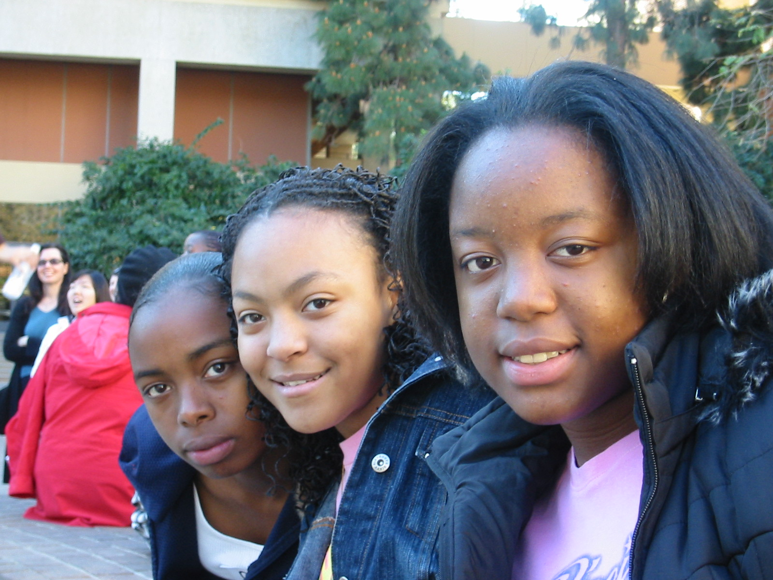
ACE THEMES
Enhancing Your Self-Image
Dealing with Emotions
Importance of Attitude
Teamwork & Cooperation
Effective Communication
Taking Positive Risks

Slide 20
ACE VIDEO

Slide 21
STUDENT ADVOCATES
Serving themselves, each other, their schools, and their communities as they become:
Critical Thinkers
Effective Communicators
Team Players
Project Planners
Service Leaders

Slide 22
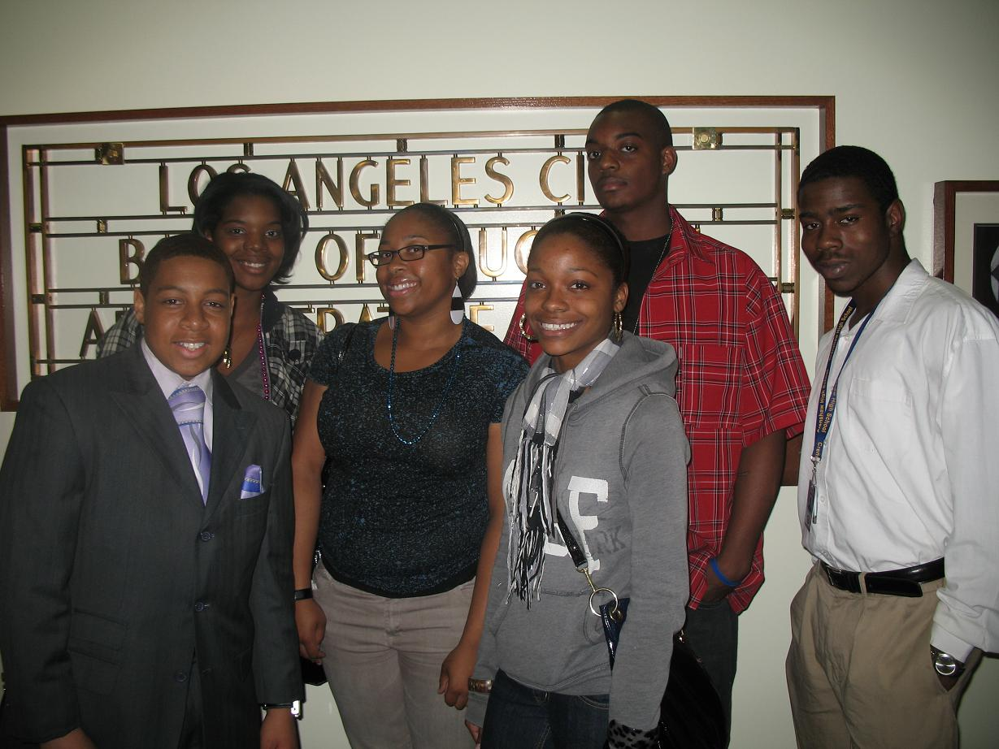
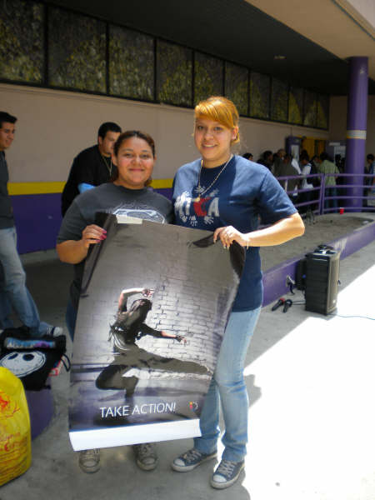
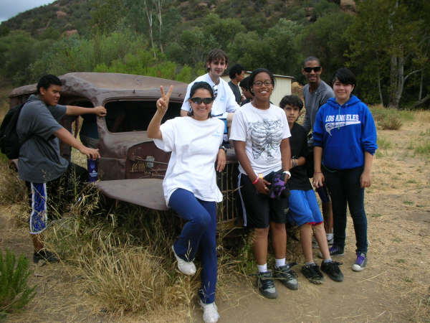

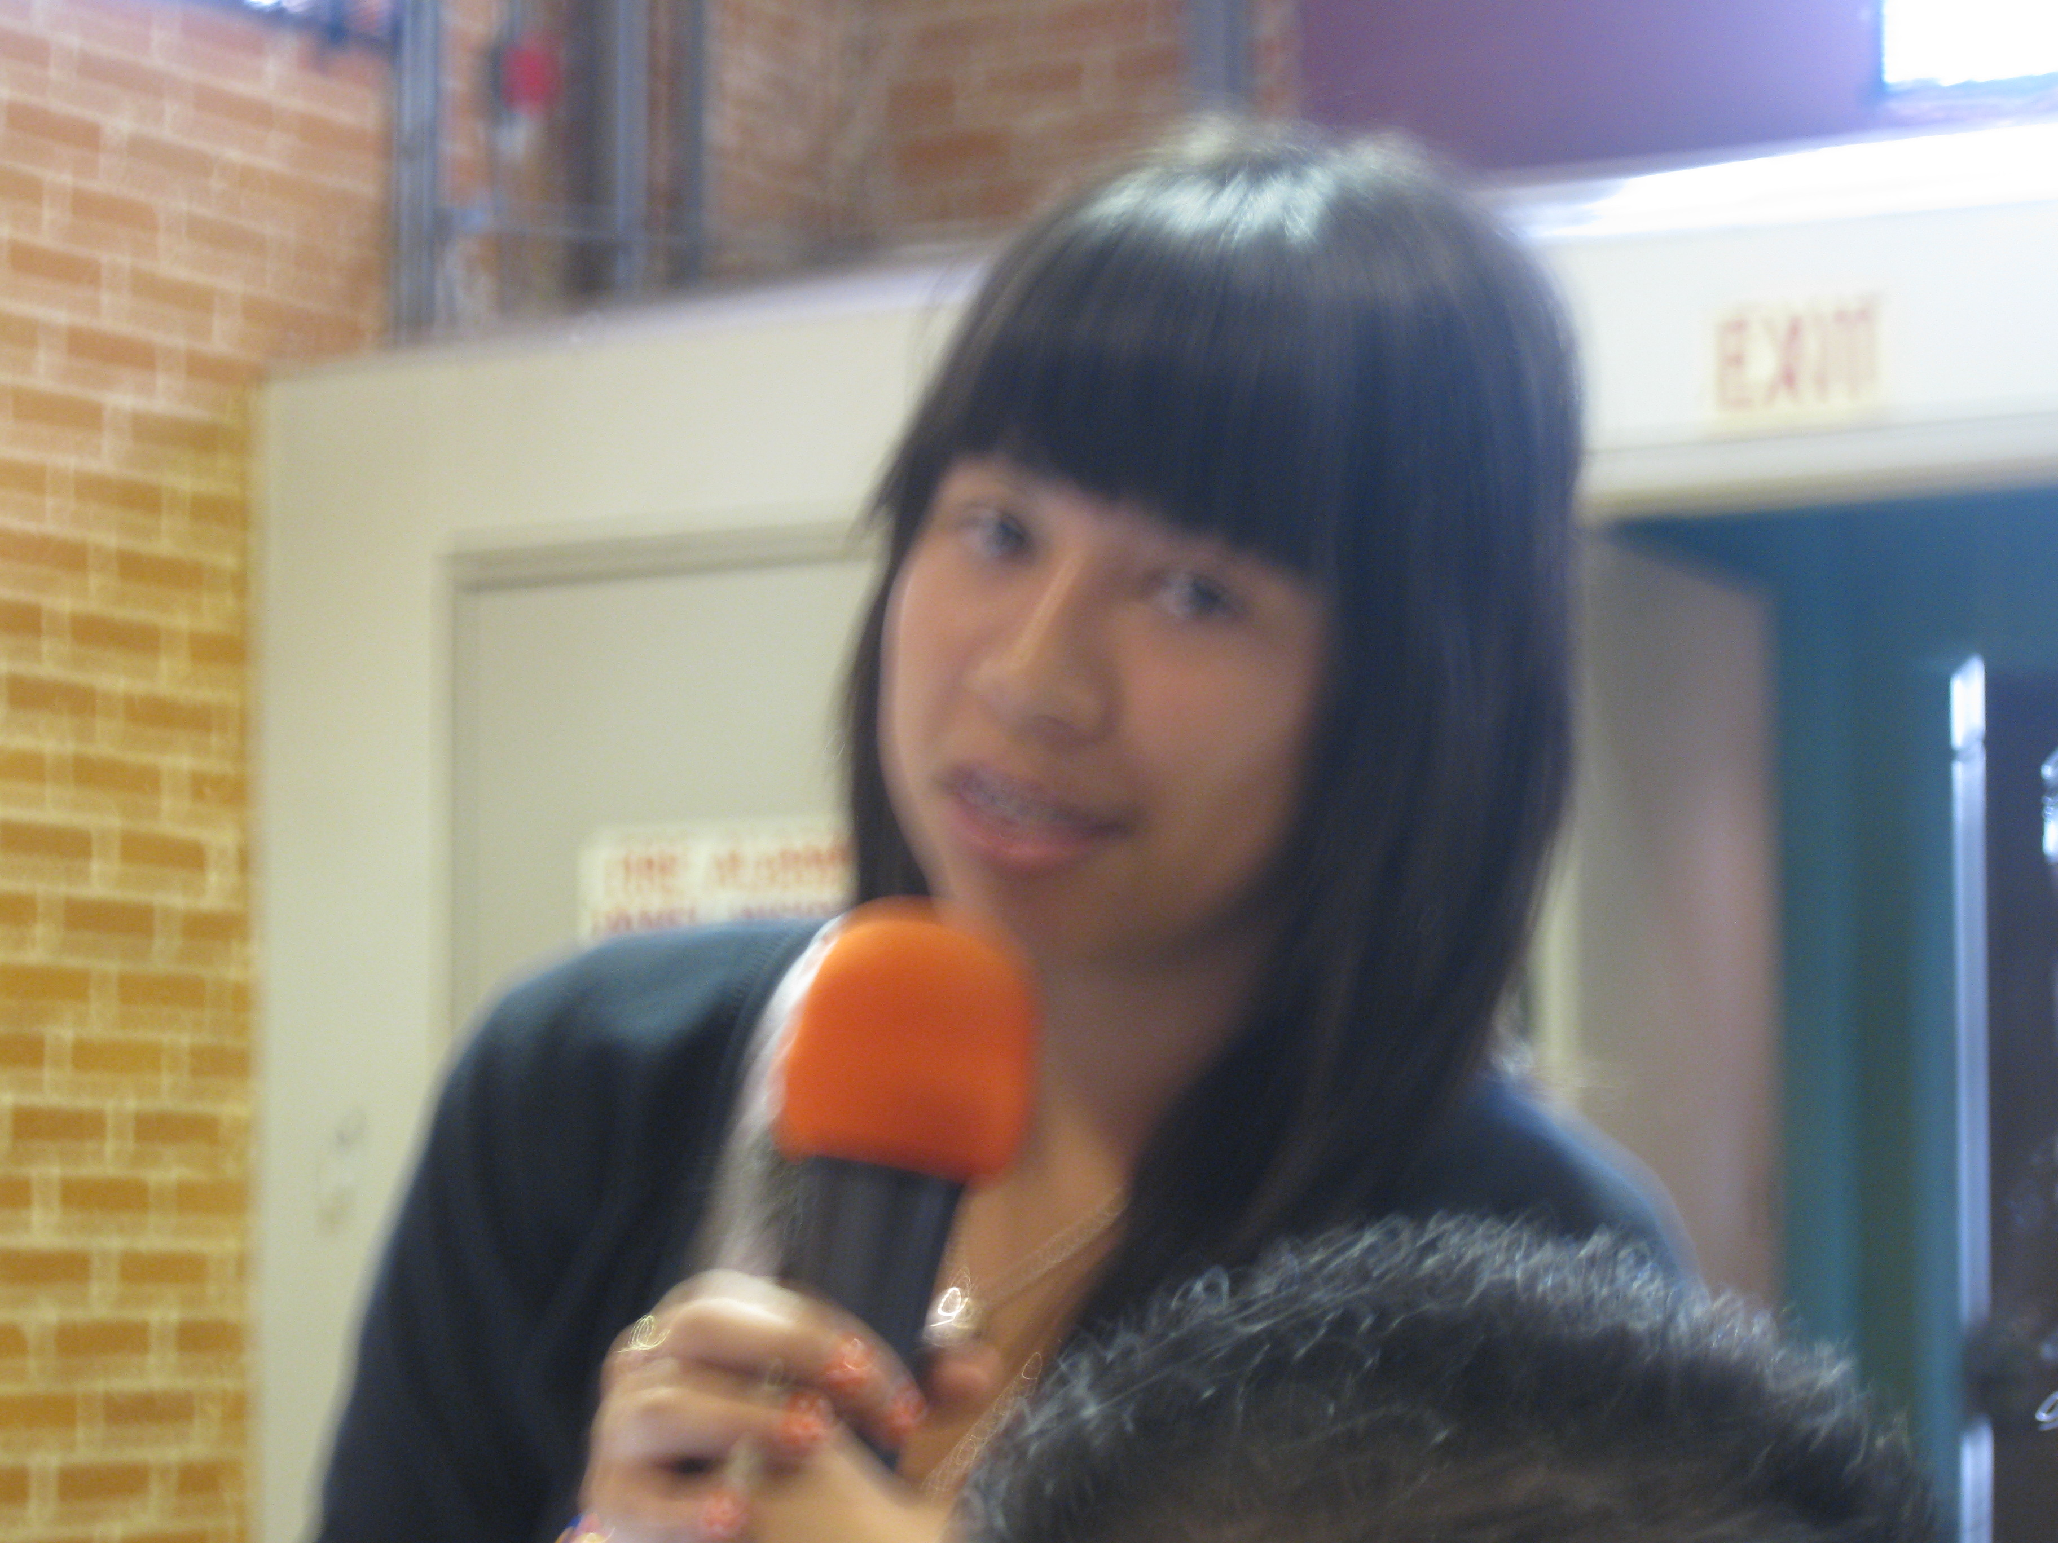
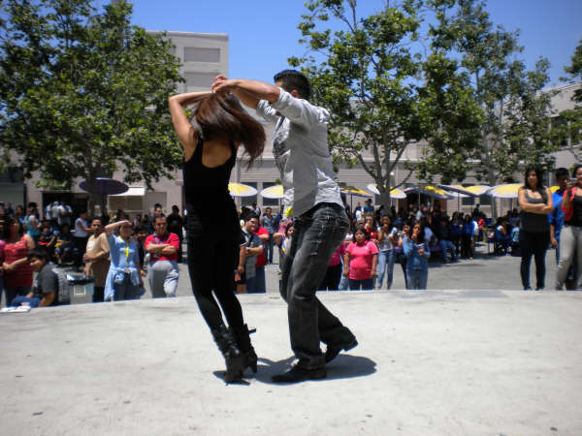
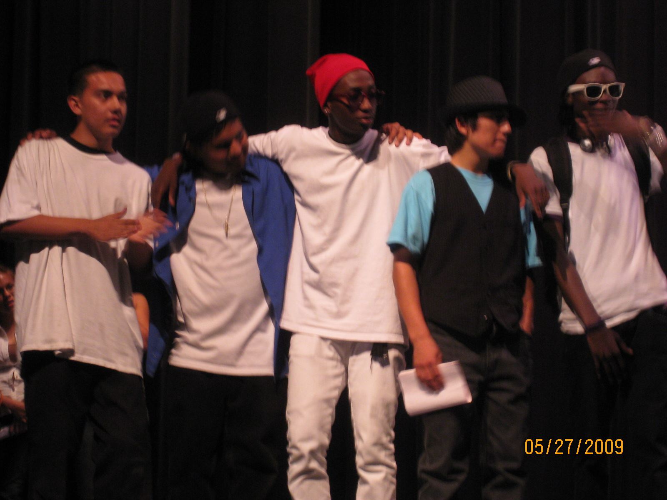
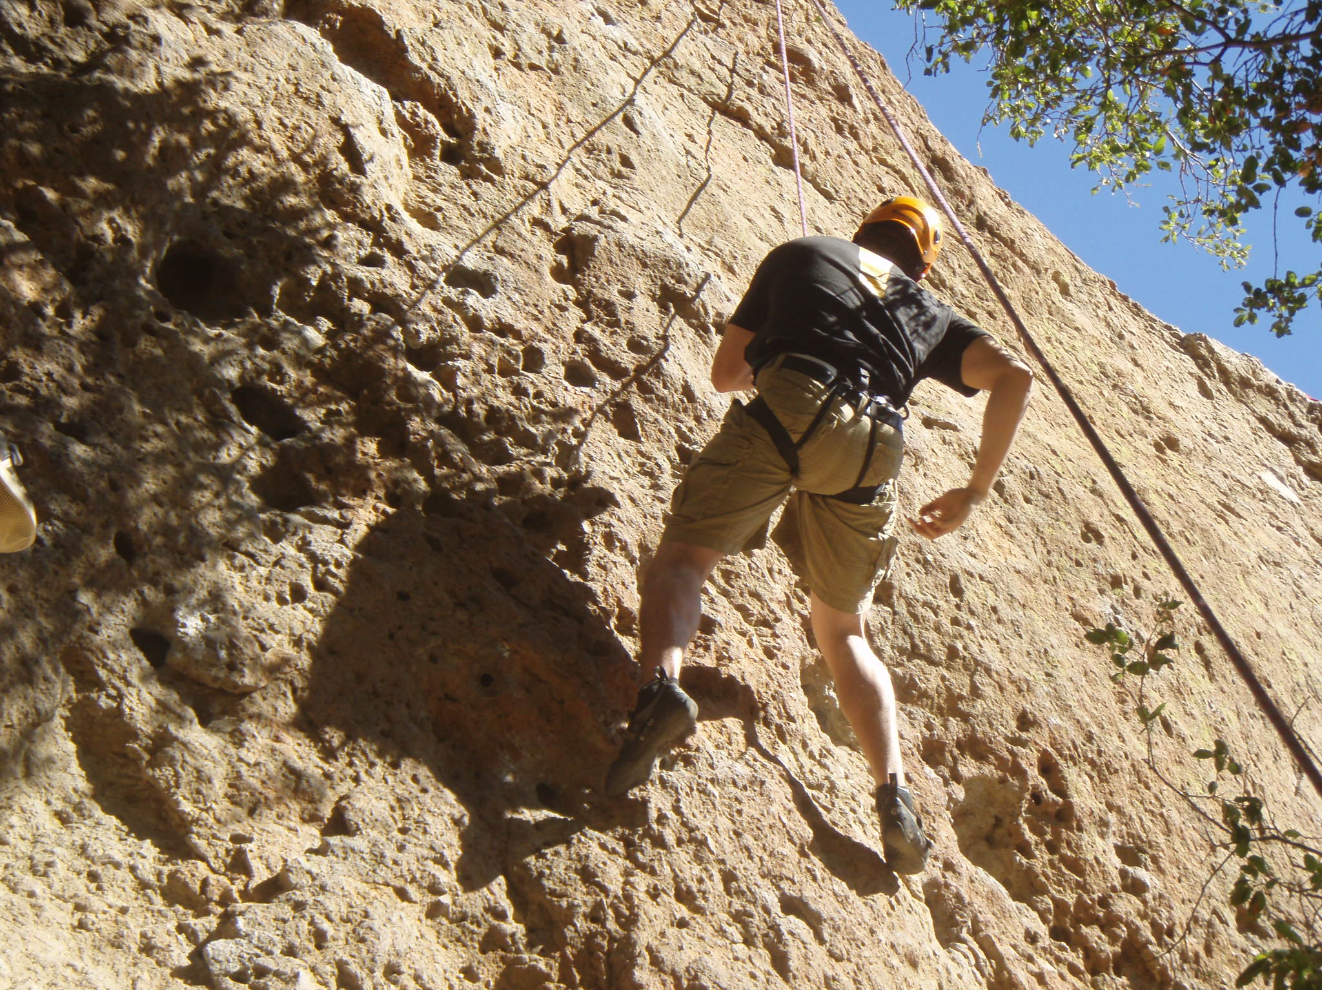
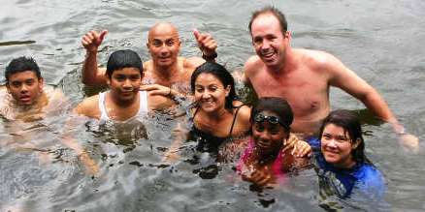
“TAKE ACTION”
LEADERSHIP CAMPAIGN
ANNOUNCEMENT!
A year-long campaign developing and showcasing students’ artistic talents & leaderships skills all while making a difference in their community
OPEN TO ALL STUDENTS!!

Slide 23
STEM
Training Retreats
Bridging Student Transitions
Service Learning Projects
Celebrating the Arts

Slide 24
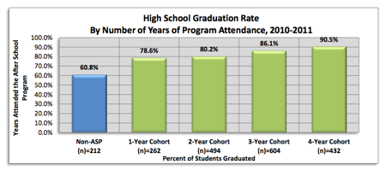
30% Graduation Rate difference by attending 4 years of
EduCare Afterschool Programs

Slide 25
EDUCARE TRANSITION MODELS
MIDDLE SCHOOL
HIGH SCHOOL
COLLEGE
“GET READY”
8th Grade
“RU LEADERS”
9th Grade
AFTER SCHOOL
PROGRAMS
“TAKE ACTION”
LEADERSHIP CAMPAIGN
ACE PROGRAMS
3-Day ACE, 1-Day ACE, Leadership Institute
ALSO: Parent Workshops, Professional Developments

Slide 26
Providing-
Professional Developments
ACE Student Success Programs
Student Transition Workshops
After School Program Management
Parent Workshops
Youth Development Curriculum
Take Action Leadership Program

Slide 27
ACE Program
EduCare Foundation
16134 Wyandotte St. * Van Nuys, CA 91604
Tel: (818) 646-5220 * Fax: (818) 646-5228
info@educarefoundation.com
www.educarefoundation.com

Slide 28
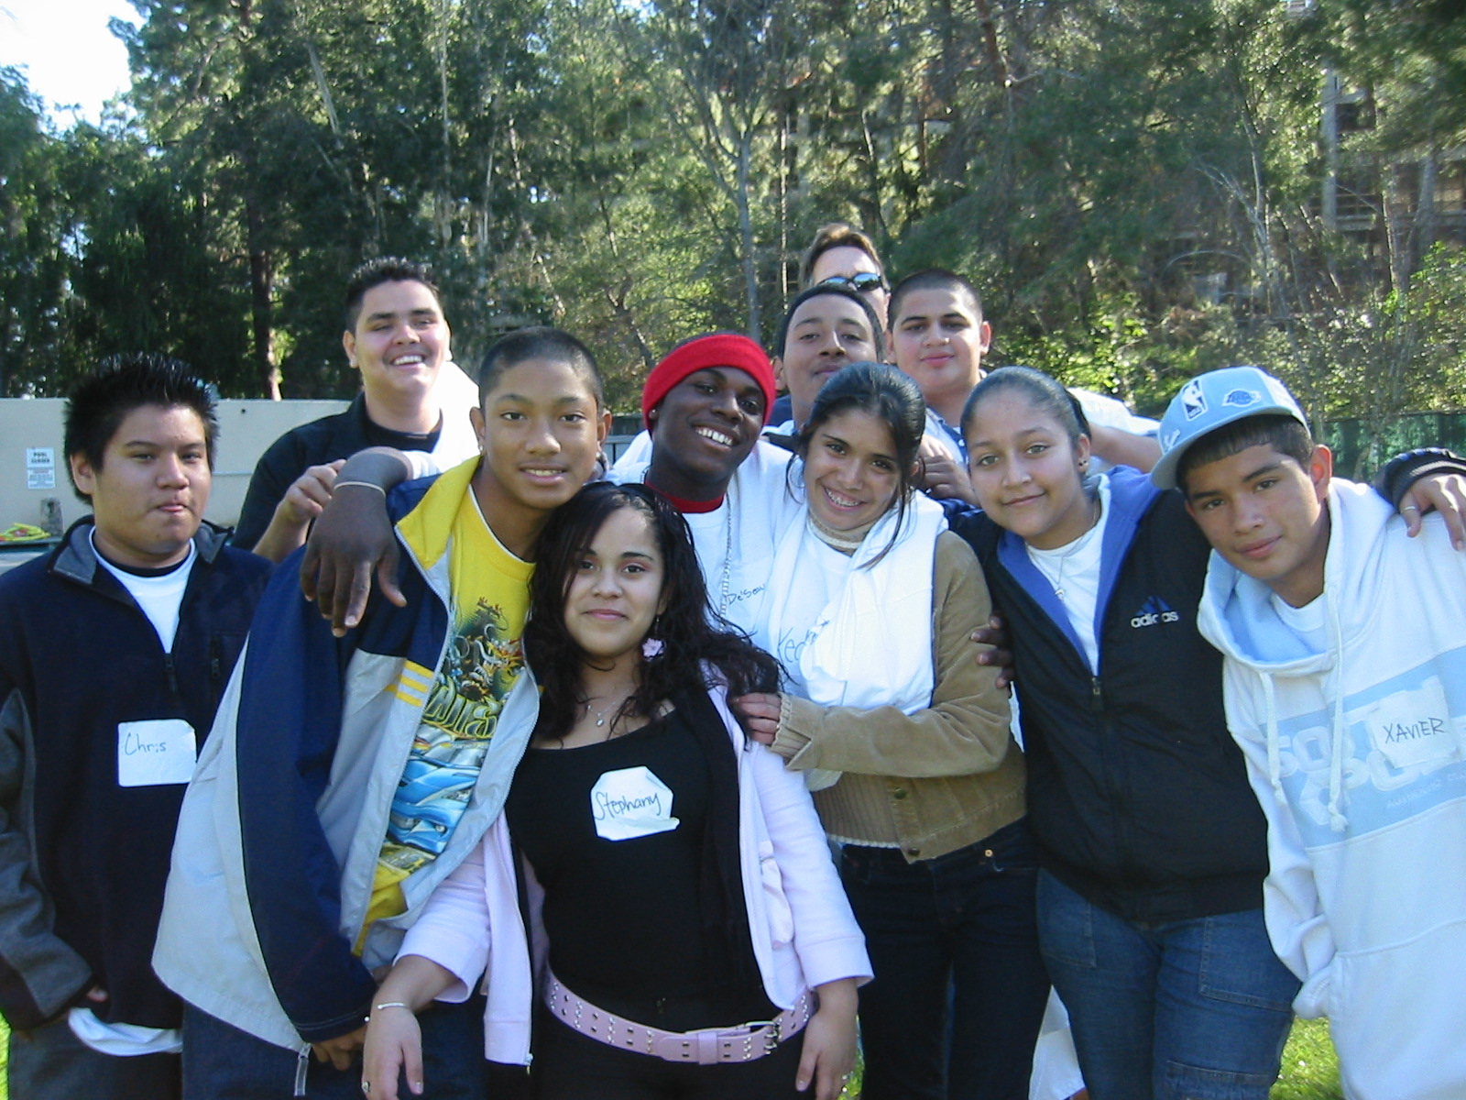
We wish you the best!

