Slide 1

More Than Just Talk: Everyday English Language Teaching

Slide 2
Your Presenter
Jennifer Kobrin
Center for Afterschool and Expanded Learning
ESOL Specialist
Notes:
School/a/s background

Slide 3
About Foundations, Inc.
In Schools, Afterschool & in the Community
Grounded in Practice
Capacity Building
Notes:
3
1 min
3

Slide 4
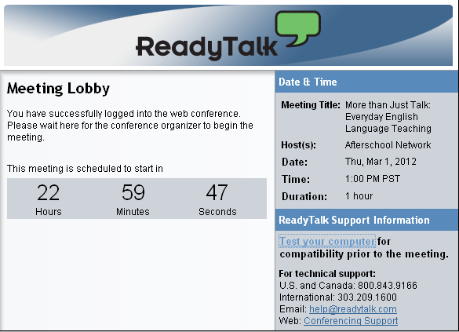
Webinar Technology
Notes:
4
4
4

Slide 5

More Than Just Talk
Activities boosting language skills
Theory and research
Supporting families

Slide 6
Today’s Objectives
  Tailor programming to meet the needs of your ELs
  Take away ideas for activities that boost academic language
  Gain ideas for building a positive environment for language learning
Notes:
Review current research on second language acquisition in the elementary grades
Discuss strategies for building cultural competence
Learn techniques for modifying existing centers to meet the needs of ELs
Take away ideas for centers that boost academic language and literacy
6

Slide 7


El Vocabulario de Hoy
Zapato
Correr
Verde
Notes:
10:19-10:26 (slides 6-7)
Go over rules
Then have everyone say the words
Then do corresponding activities for words, soliciting them from Spanish speakers
(make an origami animal such as a piggie: http://www.origami-instructions.com/easy-origami-piggy.html)
Then have them point to the words again.
7

Slide 8
Understanding
How much did you understand?

How did you feel?
 
☺😐☹
What helped or hindered?
Notes:
1:17-1:20
Debrief Q: popcorn – rate yourself 0-5 on activity 2
Rate yourself: understanding scale of 0 – 5? (none to fine) (using your fingers)
2 – 3 feelings had (bored, lost, curious, struggling, fine, amused, annoyed)
What helped you understand?
People with 0 – 2 – what might have helped?
-1: afterschool CAN help ELLs– interactive, peers/adults can help each other, more time to talk (classroom only 90 seconds talk time), great for tangible, fun projects
Doable, fun activity but stressed academic content of vocabulary words

Slide 9

What Do Language Learners Need to Improve?
Lots of time to talk!
A positive environment for language learning
Engaging activities and projects at the right level
Notes:
3 mins
Reflect on your experiences – what helped the most, what you wished you had had
Let’s rephrase these to what Luis and Min need to have to improve THEIR second language skills:
ACTIVITY
(small group or large group write in)
To summarize:
learners need to hear the language being used, naturally, with context
They need to have the opportunity to use it themselves. Test out what they know, or think they know. They need to make mistakes and get some feedback in a way that keeps with the third point listed here
They need to feel safe to make those mistakes, to not worry about being embarrassed or someone loosing patience.
Research shows us that more talking, listening and speaking, lead to faster language learning – and better listening and speaking lead to better reading and writing. When kids know the language, they are in a better place to learn how to read and write in that language.
So, Luis and Min need to get the chance to talk. How much time do you think ELLs get duirng the school day to talk – outside of recess or specifice English language classes? 90 seconds.
School-day teachers regularly acknowledge the challenge of giving more talk time to ELLs in their classrooms.
What teachers and schools can use is a partner in supporting the English language development of their students.
Becky says – live in country where everyone speaks language
Michael wished she wasn’t so afraid to make mistakes and embarrass herself
Irit says encouragement

Slide 10

Poll
Name and location of your program
% of EL students who regularly attend
Major languages spoken
Notes:
How many EL students regularly attend your program?
Just a few
About a third
A half
More than half
No se!
Major languages spoken
Spanish
Spanish plus Asian languages
Other dominant (write in chatbox)
Mix of 5 or more
Your EL students’
Home language(s)
Demographics
Ability in English
Major challenges

Slide 11
English Learners in California
Recent statistics | California | USA
Children (5-17) speaking a language other than English at home | 44% | 21%
Children of immigrants who live in low income families | 60% | 60%
% of all students enrolled that are LEP, K-12 | 24% | 8.5%
First languages spoken | 85% Spanish 2% Vietnamese | 93% Spanish 2% Vietnamese
Notes:
3 minutes
Mention handout for your reference
ELLs are the fastest growing segment of school age children. As students and as language learners they have distinct needs that are NOT likely to be met at home
MORE In CA than in any other state
BUT– if you look at the #’s, -24.4% of all students enrolled in K-12 settings are LEP in California (about 1 in every 5). In kindergarten, this rises to 50% (1 in 2). There is a lower % of LEP students in higher grades (by grade 12, it is only 11%). It has been theorized that this decrease is due to dropout rates. -- (caveat– why not reclassified– have a stat ready if I’m planning to make this point)
-majority of ELs are from monolingual communities (not getting practice time at home or in school!)
-Nationwide, there has been a 72% increase in the total # of LEP students from 1993-2003.
-14 states with 200%+ growth from 1993-2003 (a 10 year period)
Transition: -Important to think of ELL population as heterogeneous and having diverse needs. In CA only 85% are Latino/a, within that there are many different kinds of Latino/a, not blanket.
Sources:
Top languages (CA= CDE; US=

Slide 12
Why Does This Matter?
Students from culturally and linguistically diverse backgrounds often experience:
Lower achievement
High absenteeism
Overrepresentation in special education
High suspension and expulsion rates
Notes:
10:34-10:35
I want to talk a little about why it’s important to help you build your capacity to work with English Language Learners. You are all probably familiar with education research studies that state: READ SLIDE. It’s clear that these are challenges that we all struggle with and strive to remedy. But there is also an additional challenge I’d like to discuss.

Slide 13
Full Fluency: Up to 7 Years
Academic
Skills
5-7 Years
Everyday
Talk
1-3 Years
Notes:
13
10:35-10:37
Academic English – non-fiction, lots of vocab, comprehension, cultural underpinnings – 7 yrs PLUS school conventions, expectations, language
Conversational English 1-3 years
Academic English 5-7 years
This is why we have such issues helping ELL students– 7 years is a long time!
Discuss each, 2 distinct but overlapping skill sets.

Slide 14
Language Learning is NOT Linear
Native Speaker-like
Pre-production
Notes:
10:37-10:38
As students progress in language learning, they will appear to backslide, making mistakes they didn’t before. This is part of the learning process. They learn something new and test it with what they know.
I went to the movies, grandmom’s, the store. I goed to the movies, granmom’s, store…. Keep up the communication. Don’t worry. These errors are a good thing – it means they are learning!

Slide 15

Chatbox Challenge
What is the biggest challenge you face when working with your EL students?
  Cultural barriers?
  Understanding?
  Participation?

Slide 16
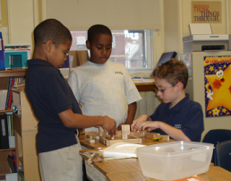
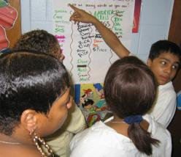
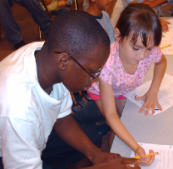
Afterschool is an ideal environment
for ELs
  Relationship oriented
  Mixed groups of kids
  Engaging activities
  Flexibility in materials,
  time, space
Notes:
Afterschool, by its very nature, is a great place for kids to be if they are learning English.
It’s relationship-oriented, it’s nurturing, there are lots of opportunities to talk, there are activities that interest and motivate kids to communicate, and there are natural examples of authentic language.
Your programs and your staff, regardless of their background, can do things that will help students learn English faster and better. Learn techniques, strategies for activities/projects, and supports for working with language learners and learning: There are lots of ways to support language learning and there are things that everyone can do – minimizing the negatives that hamper learning (criticizing all the time, being incomprehensible, isolating language learners) and adding positives that help (using gestures, motivating and engaging kids in things they love to do).
I am going to share with you now a couple of key points for staff to keep in mind as they plan for and interact with ELLs. These points underlie all of the activity ideas and strategies I will over in this segment and in Part II on (December 4th)

Slide 17
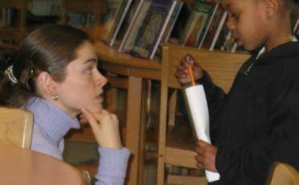
Know What You Know!
Language is a code, or system of:
Sounds
Words
Sentences
Social norms
Notes:
Language is a way we share our thoughts, feelings, needs, and it’s a way for us to share information and learn.
We can communicate without language: miming, people who can’t speak, children, violence, etc…
For most, language is our primary communication means.
Language is a code, or a system made up of a group of rules that include: sounds words sentences and norms
We know what works and what doesn’t work. Although we may not be conscious of all the choices we are making, we are following the ‘rules’ of our language.
Try This!
Make words into opposits by adding “in” but sometimes that changes.
ACTIVITY
Try this!
Choose what goes in front of the word
What pattern are you following?
Again, we are not always aware of the rules we are following, but you know when something doesn’t fit. You know that it’s not “inlegal”. So you can give feedback or help out a student who isn’t sure which one is correct.
In the same way, we know:
How to make new words (friend, friendly, unfriendly)
How to combine words together ("Peg walked to the new store." Not "Peg walk store new")
Social norms and what word combinations are best in what situations ("Would you mind moving your foot?" could quickly change to "Get off my foot, please!" if the first request got no results.)
This is what we do innately for our first language. This is what you’re acquiring if your language learner.
Kids are fully aware that they must constantly navigate between all these rules every time they open their mouths.
Staff can help by tapping what they know about langauge. The activity we just did to find the pattern, anyone can do. Great way to explore the language and talk! Language learners and English-speaking kids alike!
Language is complex and language learners will make mistakes. But with practice they will get better. Let’s move onto how to help kids practice more.

Slide 18
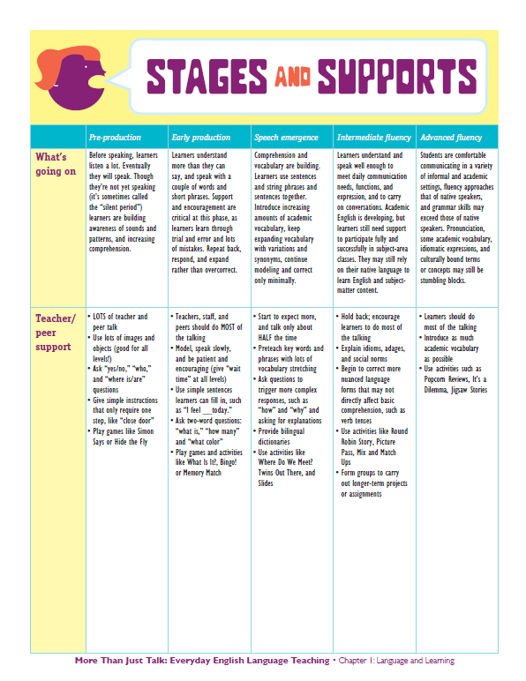
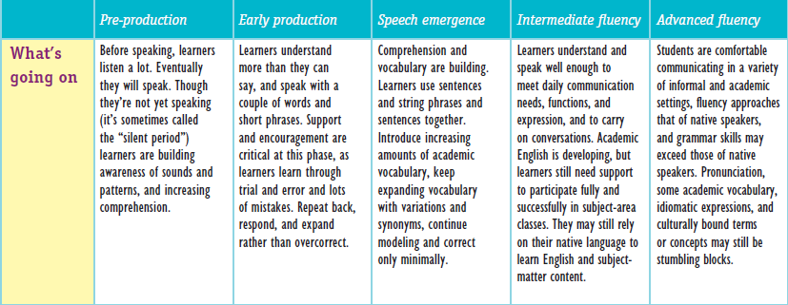
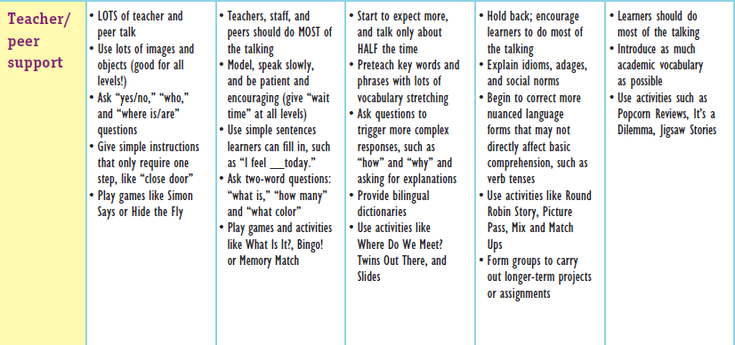

Chatbox
Challenge!
Type students’ name, stage, and 1 idea of how to support.
Notes:
10:38-10:40
Go through stages.
If time ask ELL learners or people who have traveled to another country what they experienced learning another language– try to focus comments to first words, stages you went through, etc.

Slide 19
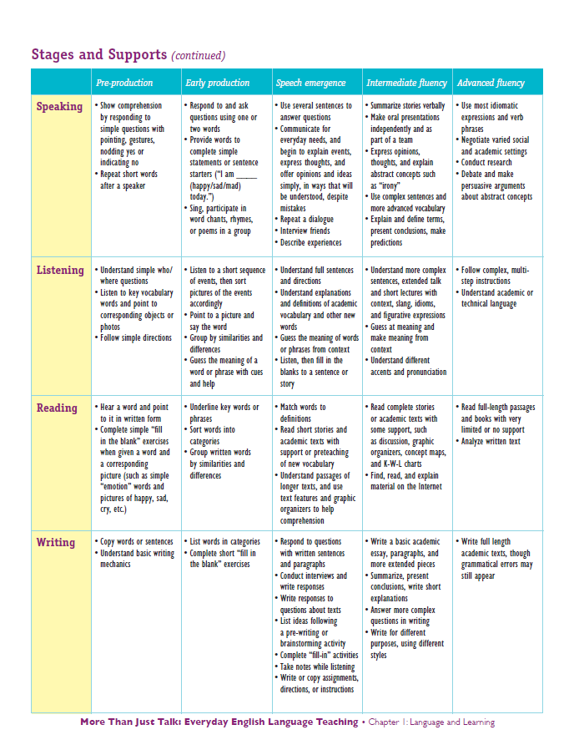
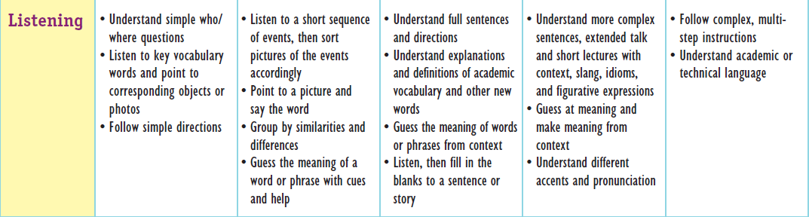
Skills:
Speaking
Listening
Reading
Writing

Slide 20

Describe and Draw
Get a piece of paper and a pencil/pen
Listen to the description
Draw what you hear
Notes:
20
20
5 Minutes
Activity Directions: Describe and Draw
[ask]
What language skills were used in this activity?
What academic skills did these activities support.
Talking Points
This is an example of an activity that engages learners, gets them practicing language, without being a language activity. Kids are using language in meaningful ways, to do a task, or solve a problem. And in doing so, they are learning – they are learning language, building academic skills, learning about culture and communication, and developing their abilities to work in teams, cooperate, collaborate, problem solve, and more.
This approach to language development is one that fits and is doable in ALL afterschool programs.

Slide 21
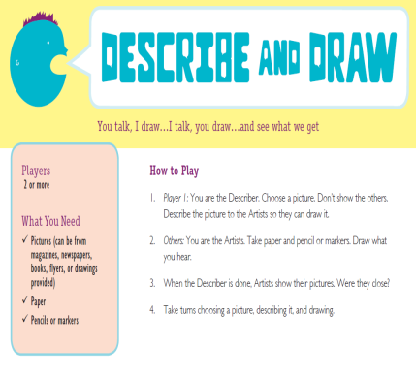
Keep it Growing!
Ratchet Down
Modify the rules (can use gestures)
Simplify the starting point or structure
Use fewer items
Ratchet Up
Modify the rules (must sit back-to-back)
Use more challenging starters (picture from magazine)
Have students make predictions
Notes:
21
how could activity ‘slides’ have been ratcheted up or down for different English proficiency levels and/or grades?
To stay on time, you probably want to just talk through this slide, rather than asking the teachers.
Talking Points:
Here are some ideas on how to modify this activities for your students.
GO through each point, think of both English language proficiency and grade level

Slide 22
Academic Language: What Is It?
Classroom register (“teacher-ese”)
  Specific instructions (assignments, group work, etc.)
  General prompts and commands
Content-specific terms (“science-speak”)
  Academic texts, homework, etc.
  Bricks + mortar

Slide 23
Academic Discourse Patterns
Each discipline or subject has its own associated terms
  Social Studies: one “speculates”
  Science: one “hypothesizes”
  Math: one “estimates”
  English: one “infers” or “guesses”

Slide 24
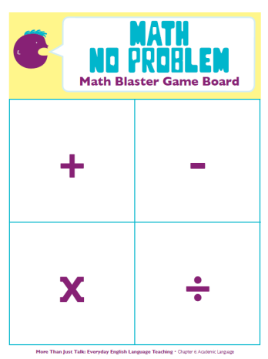
Math No Problem
Difference of
Altogether
Parts
Cut up
Notes:
24
how could activity ‘slides’ have been ratcheted up or down for different English proficiency levels and/or grades?
To stay on time, you probably want to just talk through this slide, rather than asking the teachers.
Talking Points:
Here are some ideas on how to modify this activities for your students.
GO through each point, think of both English language proficiency and grade level

Slide 25

Chatbox Challenge
  How would you modify for students in your program?

Slide 26
Keep it Growing!
Ratchet Up
Students use the cards to create word problems
Use harder vocabulary and operations
Ratchet Down
Use fewer terms
Work through example problems until students understand
Notes:
26
how could activity ‘slides’ have been ratcheted up or down for different English proficiency levels and/or grades?
To stay on time, you probably want to just talk through this slide, rather than asking the teachers.
Talking Points:
Here are some ideas on how to modify this activities for your students.
GO through each point, think of both English language proficiency and grade level

Slide 27

Building a Positive Environment
Assign group roles for activities
Group higher and lower level students together (buddy mentors)
Use a familiar routine
Notes:
10:45-10:47
Summarize bullets on slide.

Slide 28
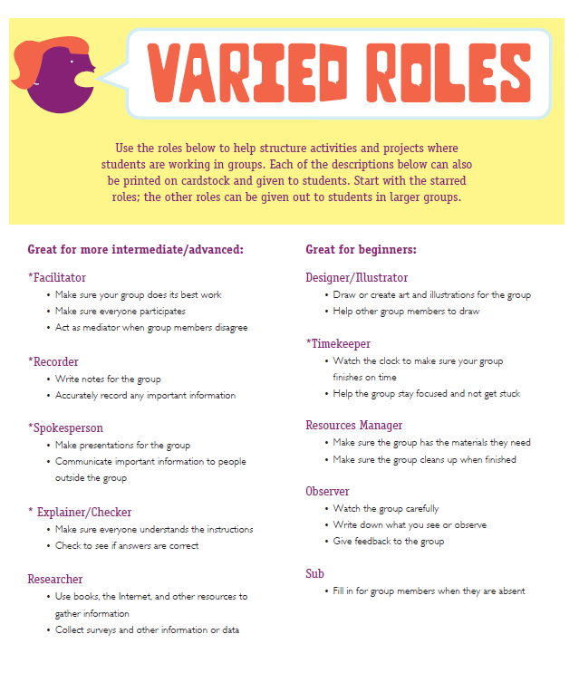
  Facilitator
  Recorder
  Spokesperson
  Checker
  Timekeeper
  Designer
Chatbox
Challenge!
How do you encourage
ELs to participate in activities?

Slide 29
Building a Positive Environment
Establish clear policies
Reflect students’ languages and cultures in your space
Remember that helping ELs helps everyone!

Slide 30
Chatbox Challenge
What have you tried to build a positive environment for ELs?
Teach words in their language
Decorate physical space
Policies
Staff training

Slide 31
Building a Positive Environment
Learn and use key words in other languages in the classrooms or hallways
“…the language rich diet of an ELL group can turn out to be nourishing for the whole mainstream class. It can help all the children use language for learning in ways which were not previously available to them.”
-(Clegg, 1996, pg. 12)
Notes:
For example - discuss slide.

Slide 32
Today’s Objectives
  Tailor programming to meet the needs of your ELs
  Take away ideas for activities that boost academic language
  Gain ideas for building a positive environment for language learning
Notes:
Review current research on second language acquisition in the elementary grades
Discuss strategies for building cultural competence
Learn techniques for modifying existing centers to meet the needs of ELs
Take away ideas for centers that boost academic language and literacy
32

Slide 33
Chatbox Challenge
Please share something you learned today.
What is one thing you plan to use?

Slide 34




Stay Connected
Visit our website
www.afterschooled.org
Visit our blog
www.languageandliteracy.org
Follow us
www.twitter.com/fndsinc
Find us
Search: Foundations, Inc.
Notes:
Evaluations and thank you’s

Slide 35


Our Resources
Information about our upcoming on-line training events can be found on our website under: PD@your.desktop
Visit our website at: afterschooled.org

