Slide 1

Using Positive Role Modeling & Mentoring to Engage Older Youth
Normandie Nigh
A World Fit For Kids!

Slide 2
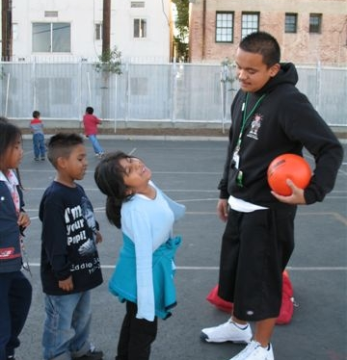
Gilberto Castellon: WFIT Teen Coach-Mentor

Slide 3
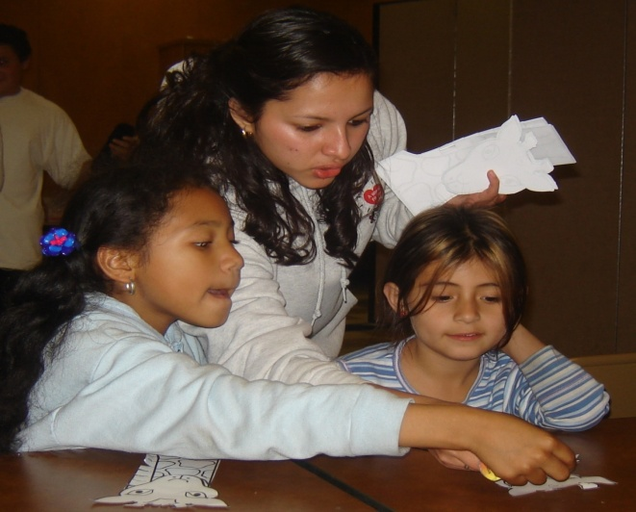
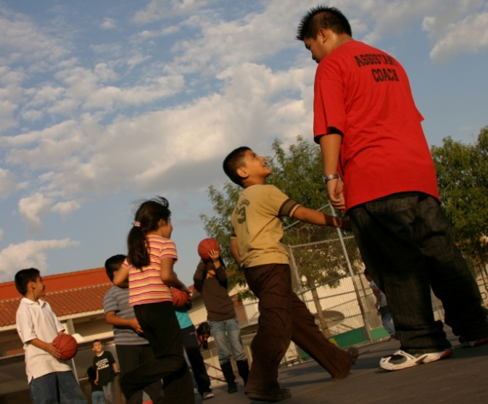
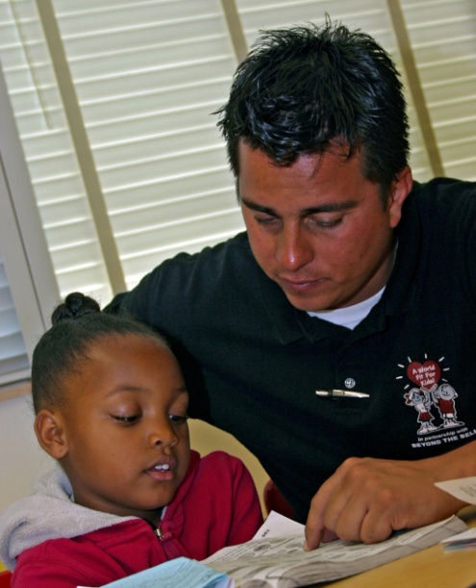
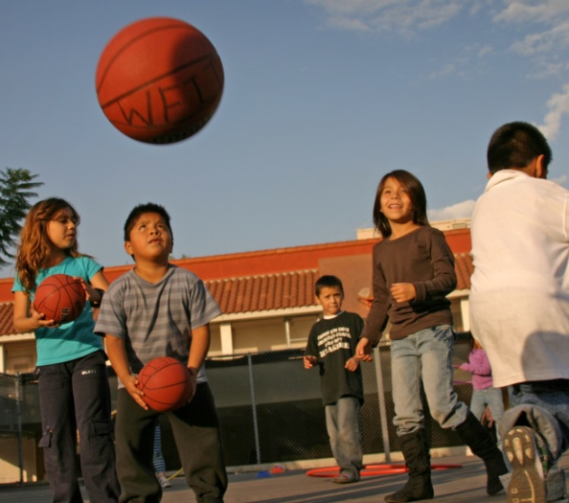
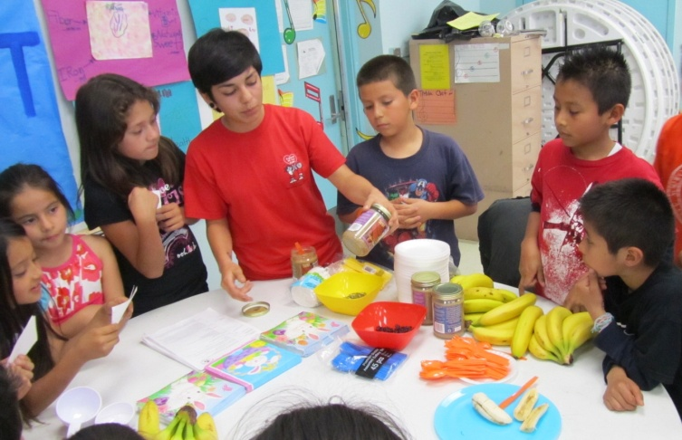
Mentors in MotionSM Older Kids Teaching Younger Kids
Becoming Healthy Heroes in their Own Communities
Through Physical Activities, Nutrition Education, and Mentoring Afterschool

Slide 4
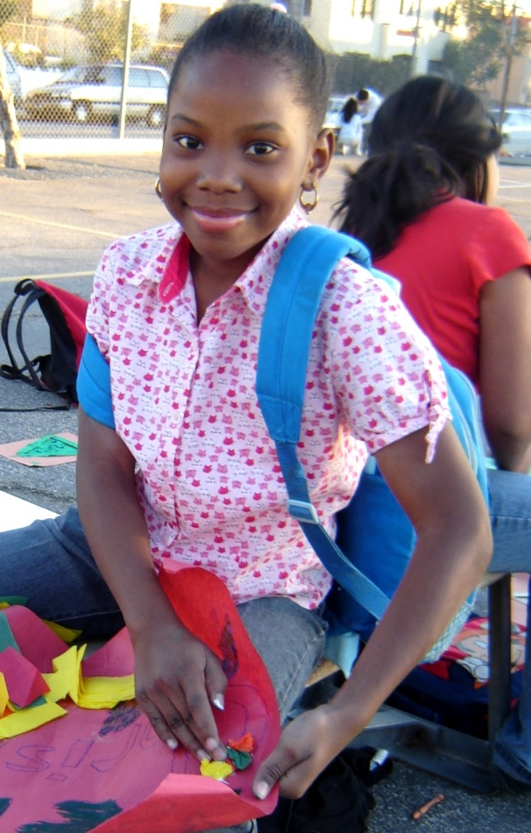
Student Outcomes!
Triple bottom line for students:
    Increased physical activity (reduction in childhood obesity)
    Increased graduation rates
    Work readiness/jobs for teens
Students also achieve results in:
    Physical fitness
    Academic progress
    School connectedness & attendance
    Confidence & competency
    Making healthy lifestyle choices

Slide 5
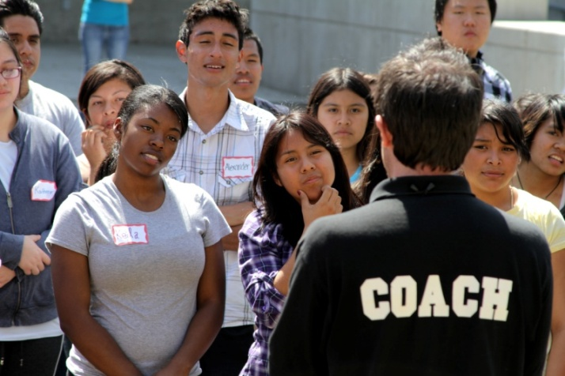
WFIT Signature Program
Mentors in MotionSM
  Healthy Behaviors Leadership Program for teens
    Physical Activity Leadership (PAL)
    Nourishing MattersSM – Nutrition Education
    Personal Empowerment
    Leadership
    Work Readiness
    First Aid/CPR
    Community Service
    Internships/Jobs

Slide 6
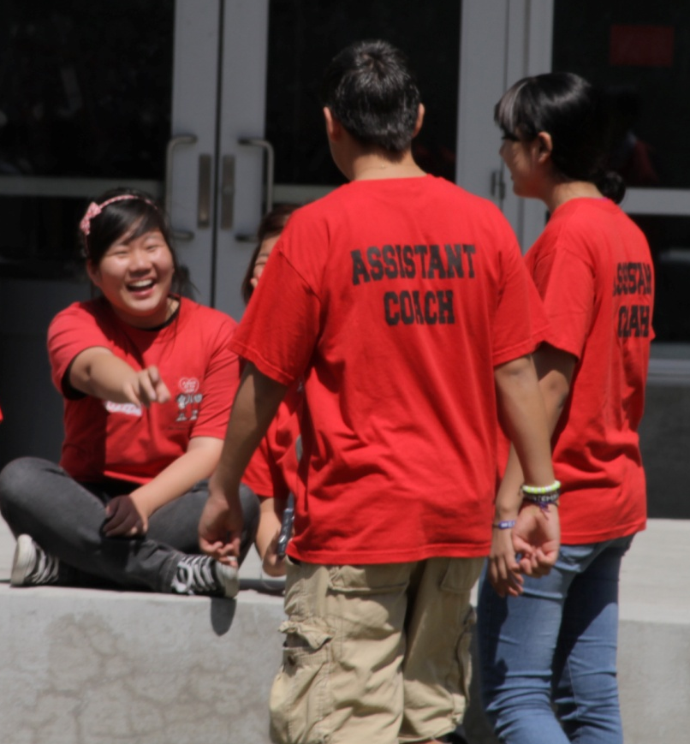
Enhance the Emotional, Mental and Physical Fitness of Teens
    “I came to the training to find a job, I gained so much more… I found my voice.”
Genisis 10th Grade

Slide 7
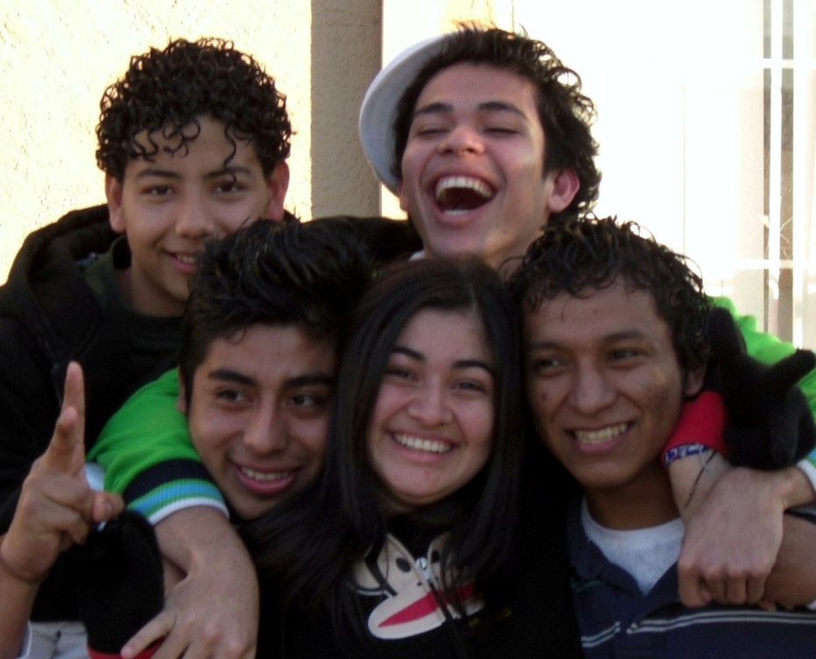
Teens - Fit for Success!
  96% Graduation Rate
  Teens completing WFIT’s 6 month training/internship program since 2003 – all from an area of Los Angeles with an average 49.5% graduation rate
83% of our trained teens continued their education beyond high school!

Slide 8
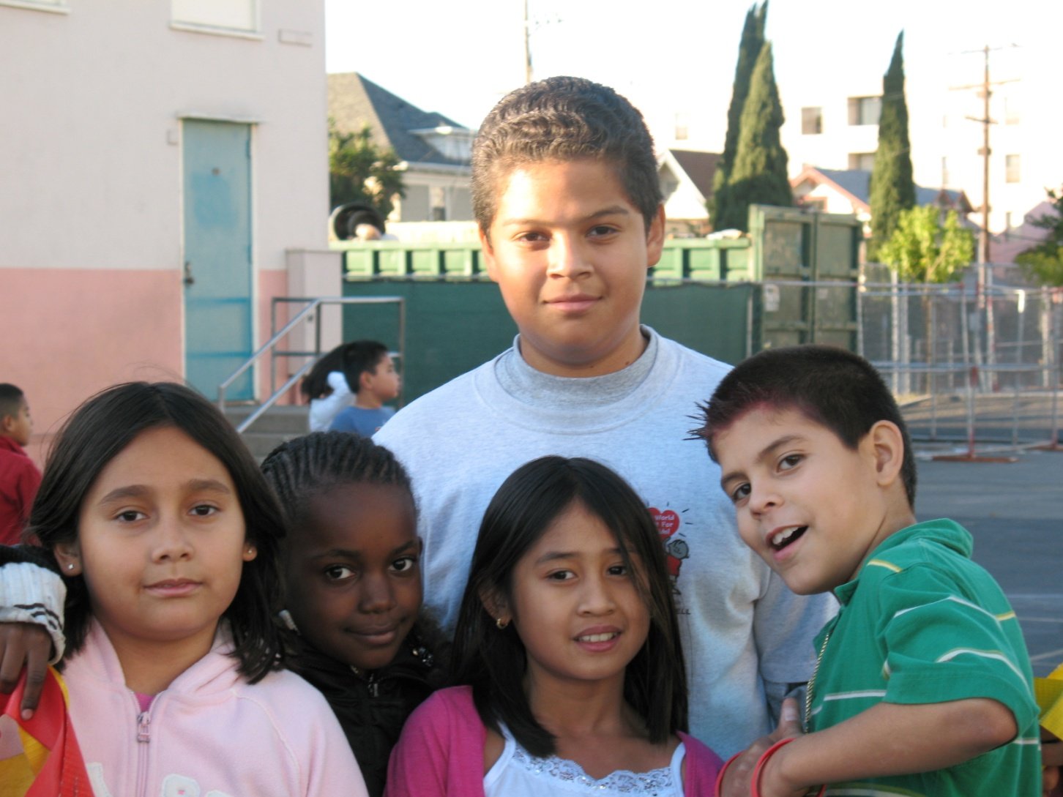
Middle School Mentors Making a Difference
Notes:
Advanced Work Readiness
Acquiring the skills and confidence required to work effectively in variety of settings; resume writing; interviewing skills; Dress for Success; business communications; how to keep a job, and phone etiquette. Students working with youth-serving agencies also receive safety training and learn how to provide homework assistance.
Advisory board
Youth Advisory Board serves to make recommendations and/or provide key information and materials to the site coordinator on issues that directly affect the student body. They assist in the development of programs and activities that reflect the needs of the community – within school and atlarge
The advisory group can be standing (or ongoing) or ad hoc (one-time) in nature.

Slide 9
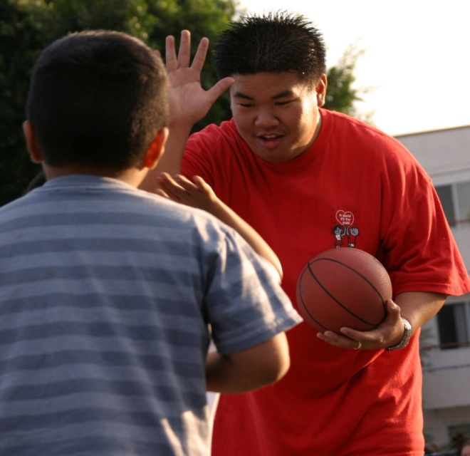
WFIT Success Strategies
Entire team committed to being positive role models/mentors
On-going professional development & support for the team
Consistent modeling & messaging of healthy behaviors
Inspire and support youth & team members to be mentors, positive role models & health leaders/advocates in their schools & communities
Share our own special gifts as a mentor with our kids & help them find their special spark or passion!

Slide 10
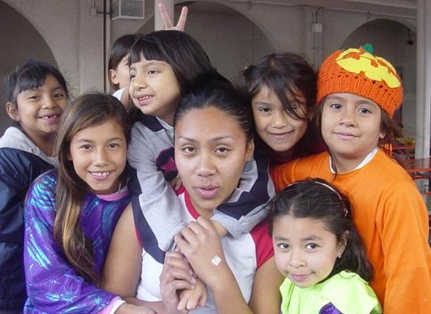
Positive Role Modeling & Mentoring Works… and changes both lives in the process!
Notes:
Advanced Work Readiness
Acquiring the skills and confidence required to work effectively in variety of settings; resume writing; interviewing skills; Dress for Success; business communications; how to keep a job, and phone etiquette. Students working with youth-serving agencies also receive safety training and learn how to provide homework assistance.
Advisory board
Youth Advisory Board serves to make recommendations and/or provide key information and materials to the site coordinator on issues that directly affect the student body. They assist in the development of programs and activities that reflect the needs of the community – within school and atlarge
The advisory group can be standing (or ongoing) or ad hoc (one-time) in nature.

Slide 11
A World Fit For Kids!
Normandie Nigh
nn@worldfitforkids.org
www.worldfitforkids.og
213-387-7712

